Slide 1
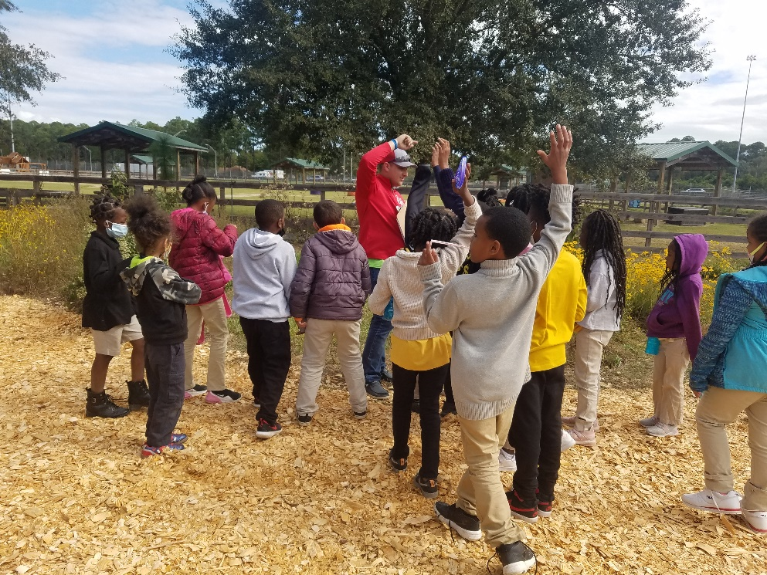
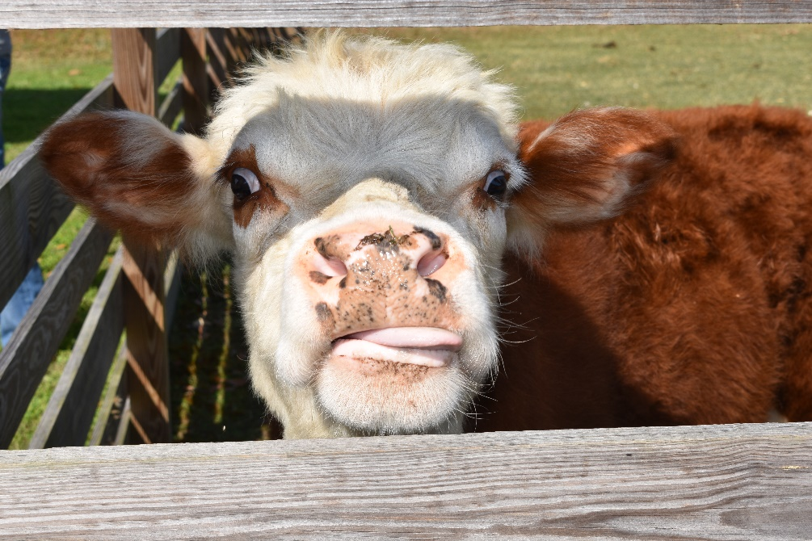
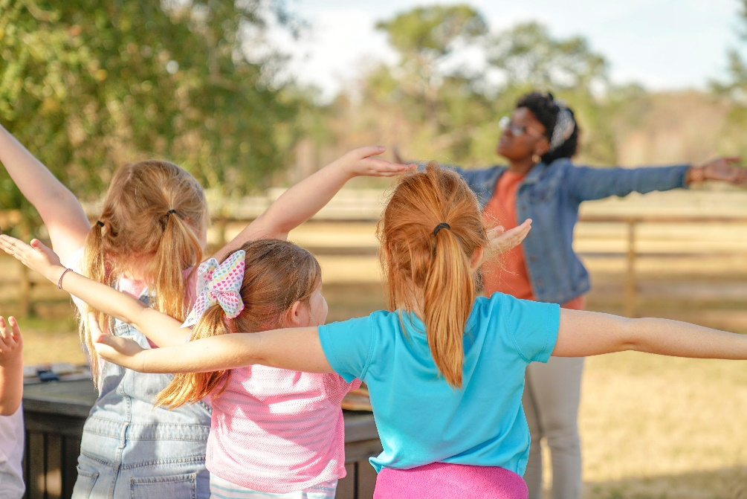
Destination Ag at the GMA!

Slide 2
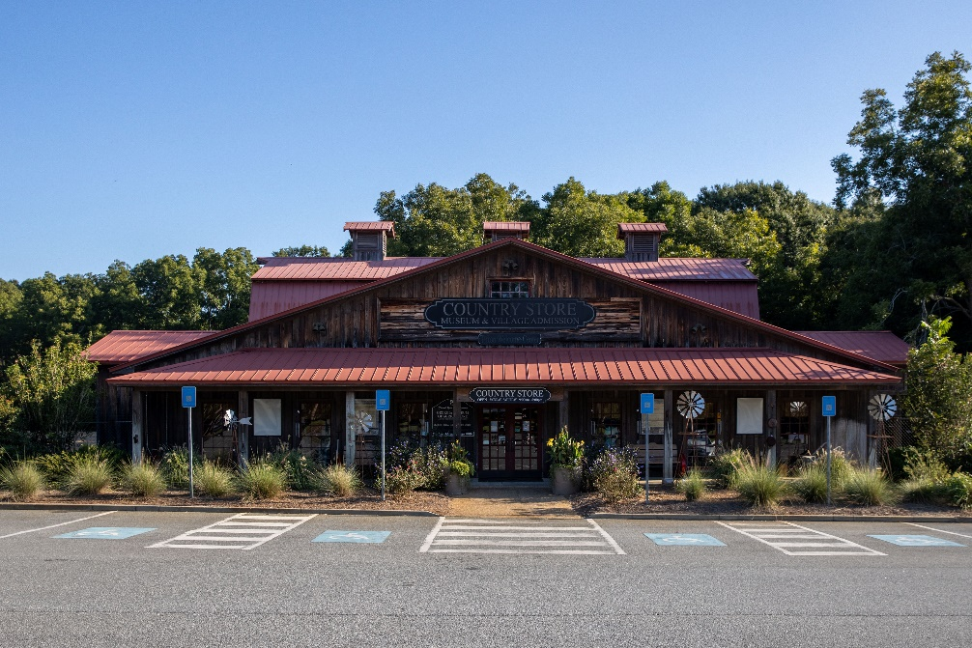
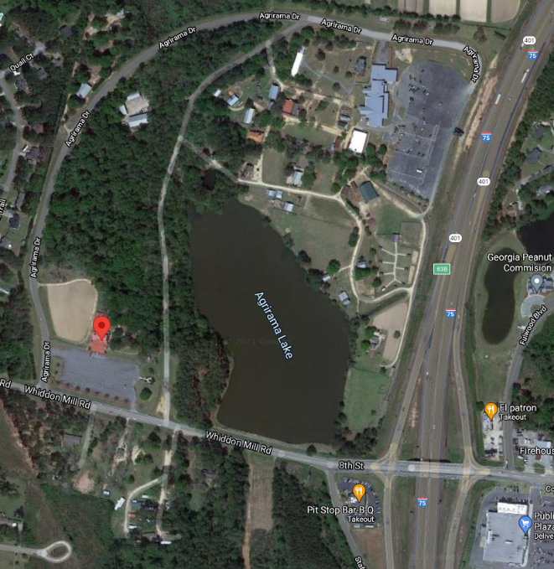
Where are we going?
ABAC’s Georgia Museum of Agriculture (GMA) in Tifton, GA.
The GMA is a place where people learn about farming in the past and present.
On our trip, we will learn about modern farming and natural resources!

Slide 3
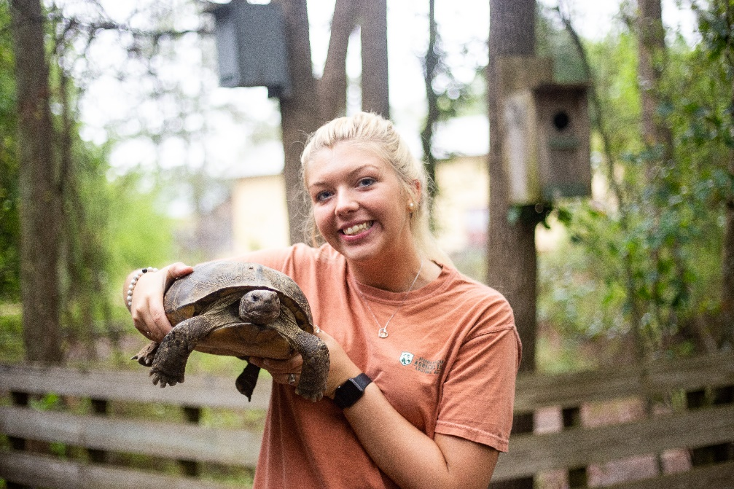
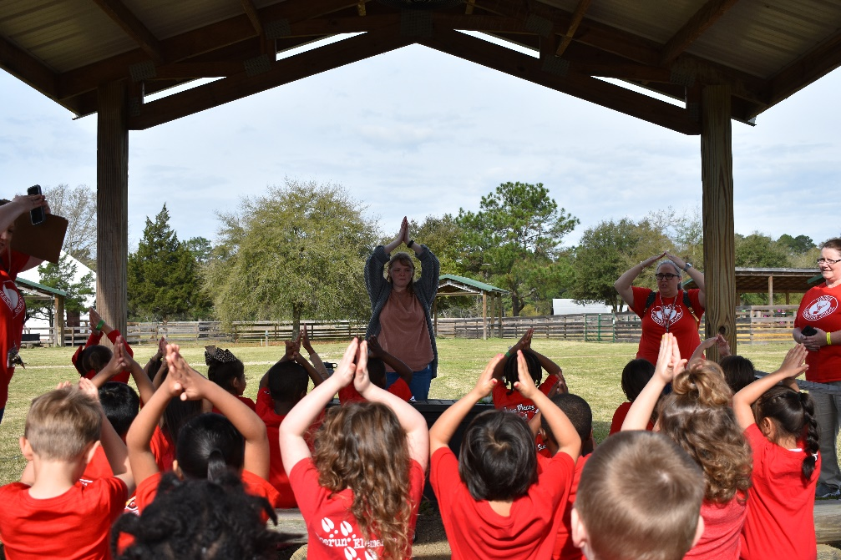
What are we doing?
We will be participating in a fun program called Destination Ag!
The main purpose of our trip is to learn about agriculture.
Agriculture is a big word that means farming.
How do you think agriculture is important to you?

Slide 4
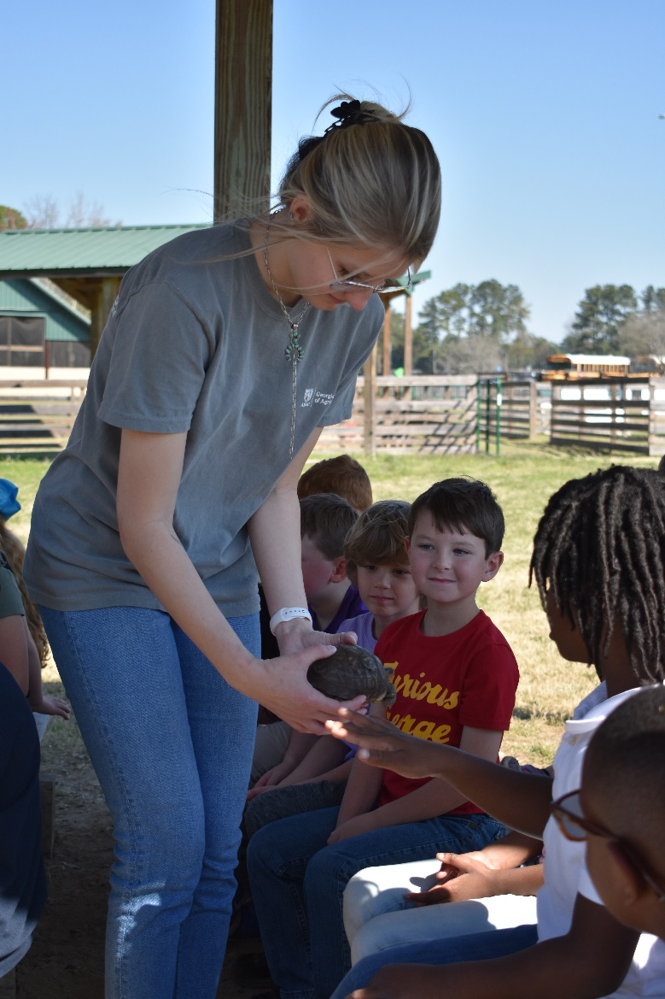
You should expect to…..
Have Fun!
Learn a lot!
Get Dirty!
Be Surprised!
Be Outside!

Slide 5
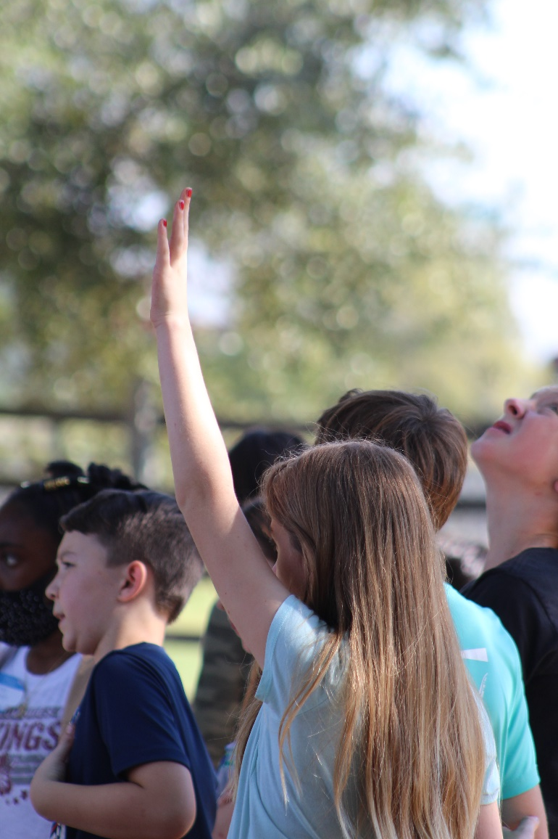
Are there rules? Of Course!
Be Respectful
Be safe
Have fun

Slide 6
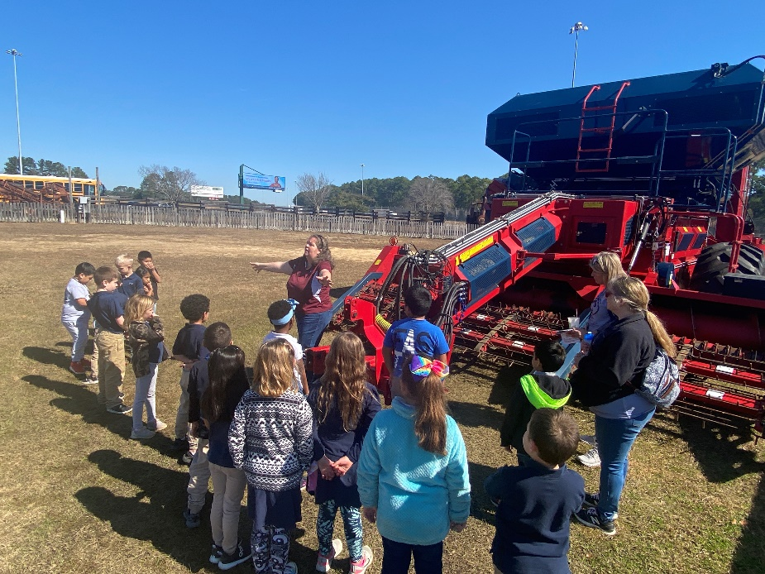
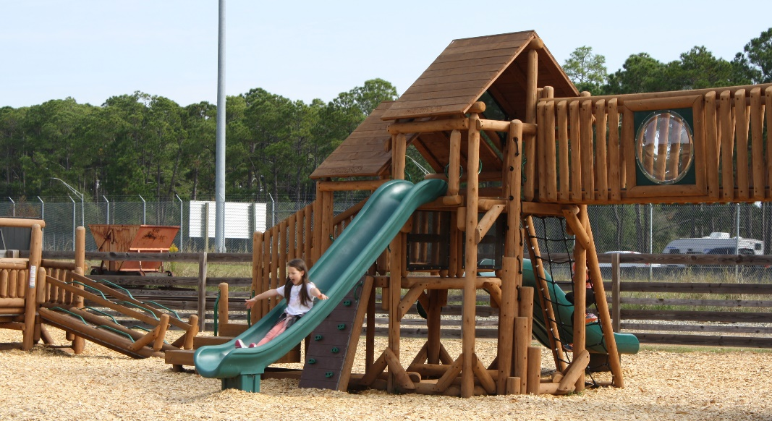
Don’t forget to…
Wear close-toed shoes and outside clothes!
Come ready to learn and have fun!
Follow the rules!

Slide 7
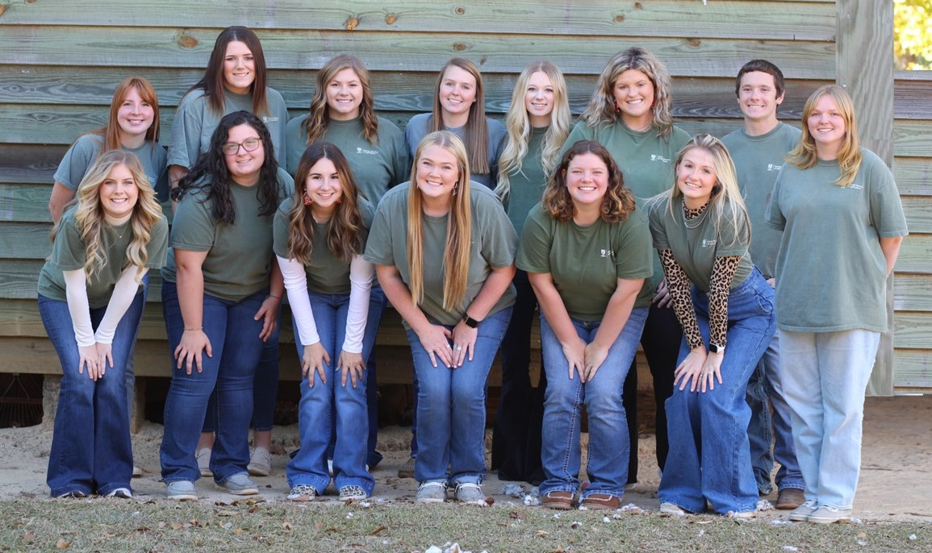
Can’t Wait to See You at the GMA!

