Slide 1
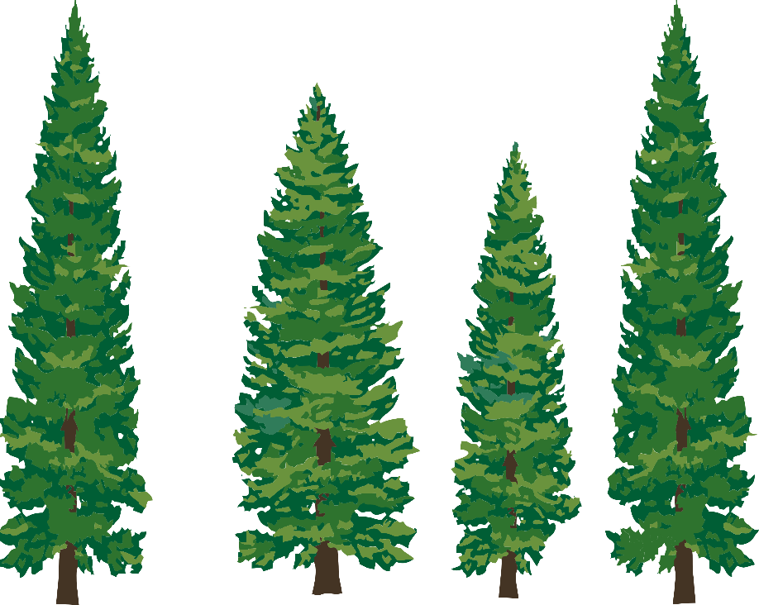
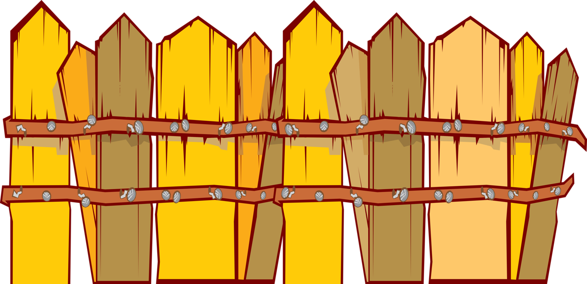

Perimeter vs Area
Our Family’s Tree Farm Math Lesson
vs
Notes:
Today we are learning (or reviewing) the difference between perimeter and area.

Slide 2
What is Perimeter?
Perimeter = the total length of all the sides of a straight edge shape.
5 inches
What is the perimeter of this square?
5 + 5 + 5 + 5 =
20 inches
Notes:
Click to define perimeter. Perimeter is the total length of all the sides (in straight edge shapes, not in circles).
To find perimeter, you need to add all the sides together.
Click to ask what is the perimeter of this square.
Click for equations. Remember, that a square has four equal sides.
Click for answer (20 inches).

Slide 3
Perimeter Practice
What is the perimeter of this rectangle?
2 + 2 + 15 + 15 =
34 inches
15 inches
2 inches
Notes:
What is the perimeter of this rectangle. Remember, rectangles have two pairs of sides that are the same length.
Click for rectangle with measurements.
Click for equations.
Click for answer (34 inches).

Slide 4
What is Area?
Area = the amount of space inside a boundary.
What is the area of this square?
1
2
3
4
5
6
7
8
9
10
Let’s draw an array and count the number of squares!
11
12
13
14
15
16
17
18
19
20
21
22
23
24
25
25 squares
Notes:
Click to define area. Area is the amount of space in a boundary (in straight edge shapes, not in circles).
Click to ask what is the area of the square?
Click to show “Let’s draw an array and count the number of squares.” This will help us solve the problem.
Click to show array lines. Remember, area will be the number of squares inside the box.
Click: to start counting the squares (number will appear automatically).
Click to show answer (25).

Slide 5
Area Practice
Let’s try again. This time with our rectangle.
Length x Width = Area
15
x
2
=
30
30 squares
1
2
3
4
5
6
7
8
9
10
11
12
13
14
15
1
1
2
3
4
5
6
7
8
9
10
11
12
13
14
15
2
16
17
18
19
20
21
22
23
24
25
26
27
28
29
30
Notes:
Let’s try again with our rectangle. Click for rectangle to appear.
Instead of counting each square, let’s use the area math formula: Length x Width (click to show equation).
For our rectangle, we have 15 squares across and 2 squares down (click to count the squares).
Let’s place these numbers in our formula.
Click to add 15 for length.
Click to add 2 for width. What’s the answer?
Click to show 30.
So this rectangle has an area of 30 square inches (click to show 30 square).
Let’s count to make sure we are correct!
Click to start the automatic counting of the squares

Slide 6

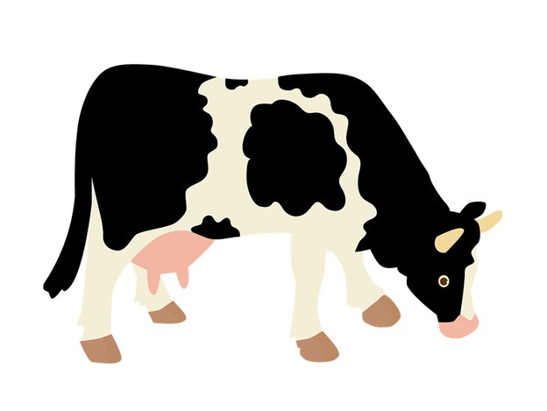
Real World: When Do We Use Perimeter?
Fencing! Farmers use perimeter to determine the amount of fence needed to surround a field.
How much fencing does the farmer need to keep the cows out of the tree farm?
365 ft
648 ft
365 + 365 +648 + 648 =
648 ft
2,026 feet
365 ft
Notes:
Farmers use perimeter to determine how much fence they need to surround a field.
Let’s solve a problem. Click to show farm and problem.
What do we need to know? How much fence to buy to surround the cows.
Click to show fence and numbers.
Let’s add the sides of the fence together. Click to show equation.
Click to show answer (2, 026 feet).

Slide 7
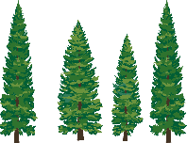
Real World: When Do We Use Area?
Farmers use area to help find the needs of the farm. For example, once a tree farmer knows the area of the farm, he/she can use that number to decide how many tree seedlings to plant to cover that area.
Step 1: Find area
Length x Width = Area
8 acres
3 x 8 =
24 acres
3 acres
3 acres
Notes:
Farmers use are to help them determine different needs of the farm.
Let’s solve a problem. Click to show farm and numbers.
Let’s first determine the area. Click to show verbal equation Length x Width = Area.
Let’s include the numbers we need for the equation. Click to show the numeral equation.
Click to show answer (24 acres).

Slide 8

Real World: When Do We Use Area?
How many seedlings does the farmer need to buy if he/she plans to plant 50 seedlings per acre?
Step 2: What do we know?
8 acres
24 acres are available for trees on the farm
plant 50 seedlings per acre
1 acre
24 acres
x
50 seedlings
=
3 acres
1,200 seedlings
Notes:
Here’s a common real world problem that we will use area to help solve. Click for problem.
Remember from Our Tree Farm that tree farmers plant seedlings after they harvest.
Tree farmers need to know how many seedings they can plant.
Click for Step 2. What do we know?
Click to list what we know (they come up individually): farmer wants to plant 50 seedlings per acre and tree farm has an area of 24 acres (from our 1st step).
How do we find out how many seedlings to buy for the total 24 acres?
Each acre (24) will have 50 seedlings planted (click to show these numbers in an equation). To give us the total number of seedlings needed for the farm, we need to multiply the number of acres and the number of seedlings per acre. Click to show operations.
Click to show answer (1,200 seedlings).
Now the farmer knows how many seedlings to buy to plant his tree farm.

