Slide 1
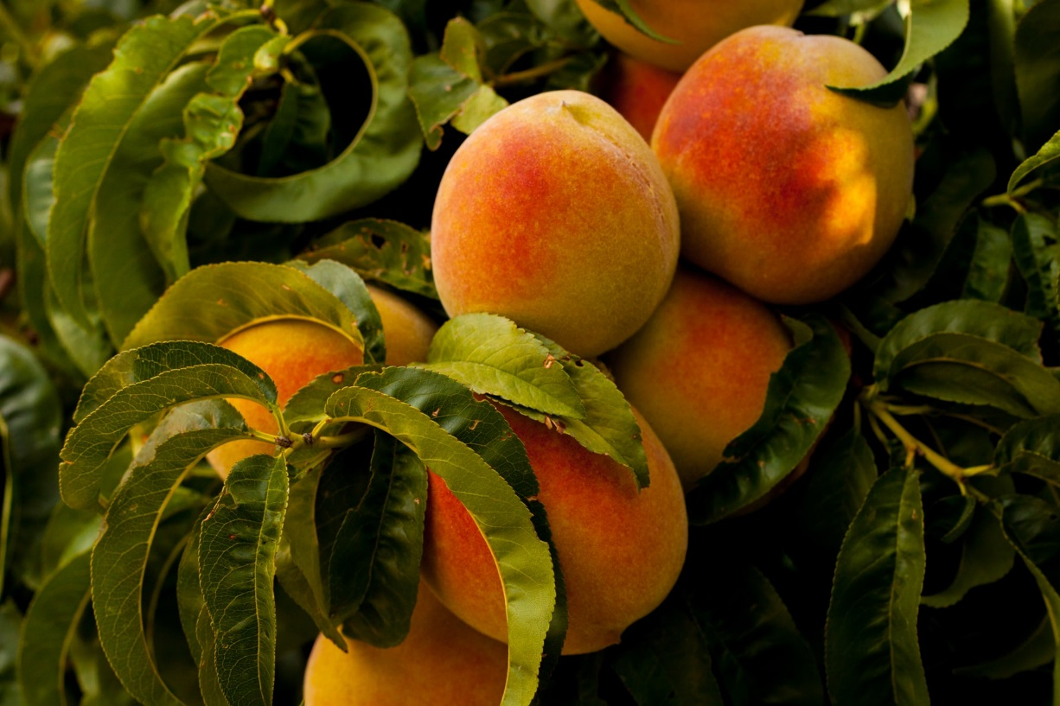
Coming Together for U.S. Economy
Grade 5

Slide 2
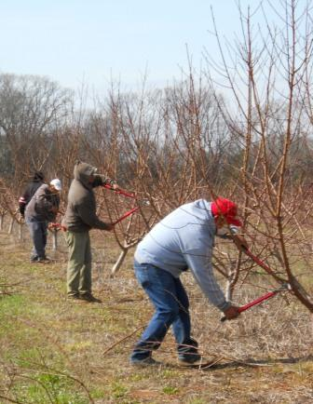
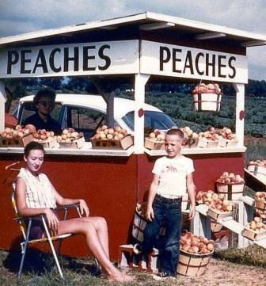





What are the different sectors of the U.S. economy?
Household
Private
Bank
Government
Notes:
Who can tell me the different sectors that play a role in the United States economy? (household, private, bank, government; click for text boxes)
What two sectors are represented in My Family’s Peach Farm book? (household and private; click for outline)
Who are the households? Click for text box
Could a college student living on campus be a household? Yes!
Households are the customers (or consumers), individual or family, who buy the good or service being offered from the producers. Click for photo. You will be a consumer if you try some of those yummy recipes on page 21!
Who are usually the producers? The private sector! Click for outline
In My Family’s Peach Farm, the Pearson Farm is the producer. They are considered a part of the private sector. Click for photo
The grocery stores and restaurants that buy the peaches from the Pearson Farm area also examples of the private sector. (pg19)
Besides selling the goods/service to the households, there is another way the private sector is connected to the households. Anyone know?
Here’s a clue. Do you think the Pearson’s run their family farm all by themselves? No! They pay individuals from households to work on the farm. Click for photo
The grocery stores and restaurants must hire workers to stock the food, work the cash register, and keep the business clean. These workers come from the household sector.
Click to show arrows. So these two sectors are closely connected to each other. Probably more closely than you think!
Click for next slide

Slide 3

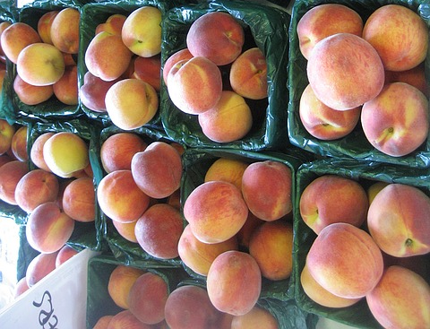

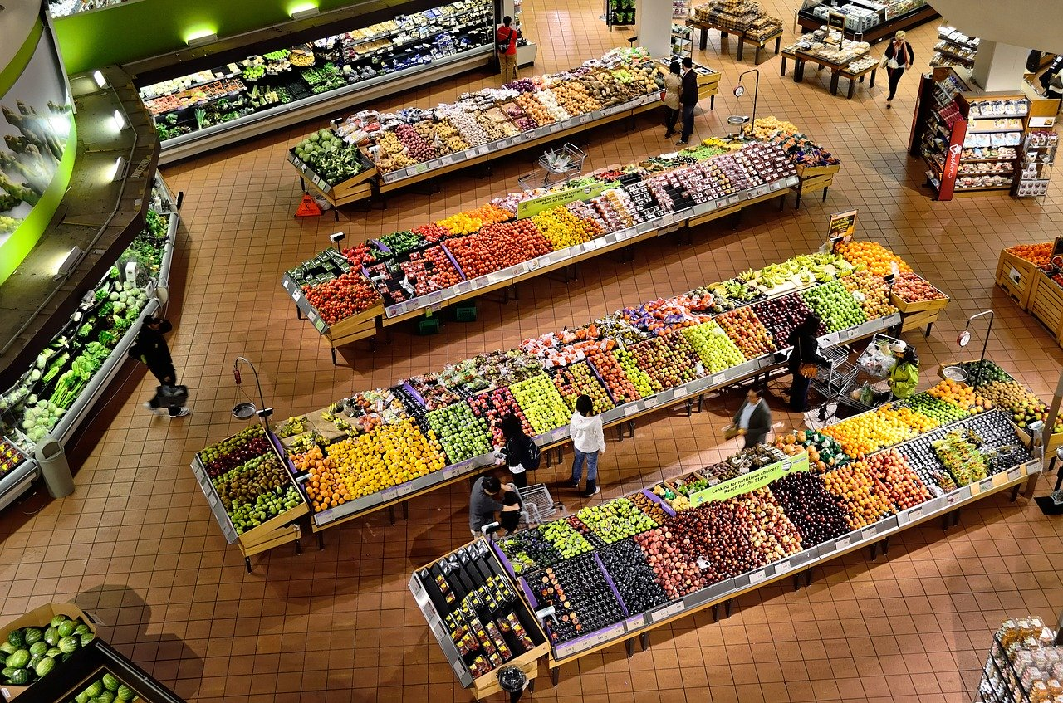





Local Farm Peach Stand
Grocery Store
Notes:
Let’s say we have two households. Household A are the Garcias, Household B are the Johnsons. Click for clip art
Both households want to buy peaches to make desert that night. Click for photo
They have two choices of where to buy their peaches, (Click for photos)
A peach stand which is run by the local peach farm, or
A grocery store.
The Garcias decide to pay a little extra money for the peaches and buy them from the local peach stand and the Johnsons decide to spend less money and buy the peaches from the grocery store.
Are both these households contributing to the economy? Yes! Click for photos
What are the local peach stand (farmer) and the grocery store examples of? Private sectors
So if they are both a part of the private sector, why do they charge a different price for the peaches?

Slide 4


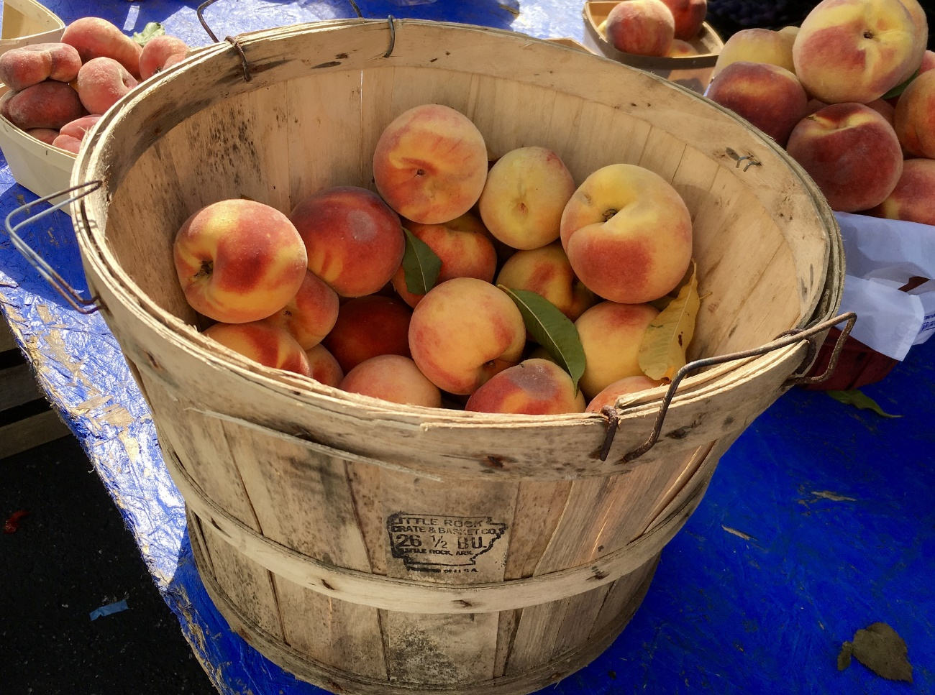

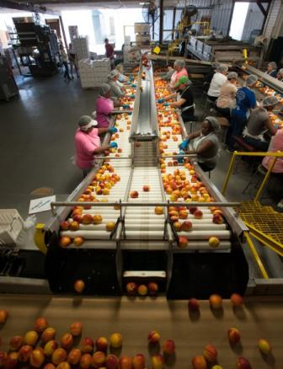

What goes into growing peaches?
Natural Resources
Capitol Resources
Human Resources
Notes:
Let’s take a look at the peach farmer, Suzzy, running her own stand. Click for photo
What resources does it take for Suzzy to grow her peaches? Use My Family’s Peach Farm to help list those resources. Click for clip art
Natural resources: soil, water, and the peach seeds (trees)
Human resources: workers to help prune, harvest, and package the peaches Click for Examples
Remember the workers come from the household sector!
Capital resources: all the machinery and tools (tractors, wagons, cash register, etc) Click for Examples
Are these resources free? No! All those resources come at a cost to Suzzy.
She may have to pay mortgage on the land and a water bill for irrigation.
She has to pay her workers so they then can support their family/life, making them consumers in the economy.
Once bought, the machinery needs to keep working so there is a cost for maintaining (like a car and getting the oil changed) it.
Suzzy, the peach farmer, must cover her costs of growing the peaches as well as have enough money to support her family/life.

Slide 5
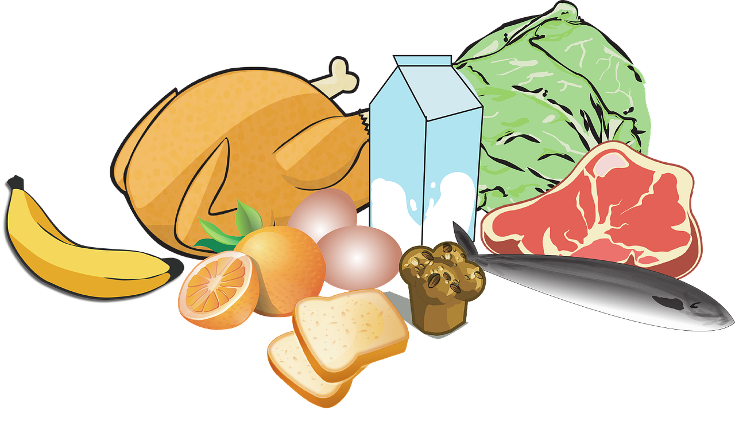
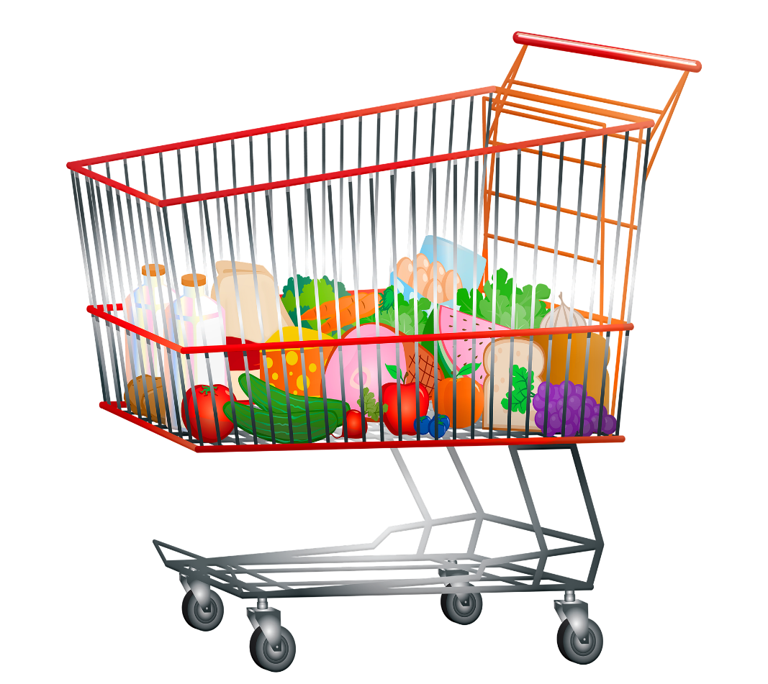
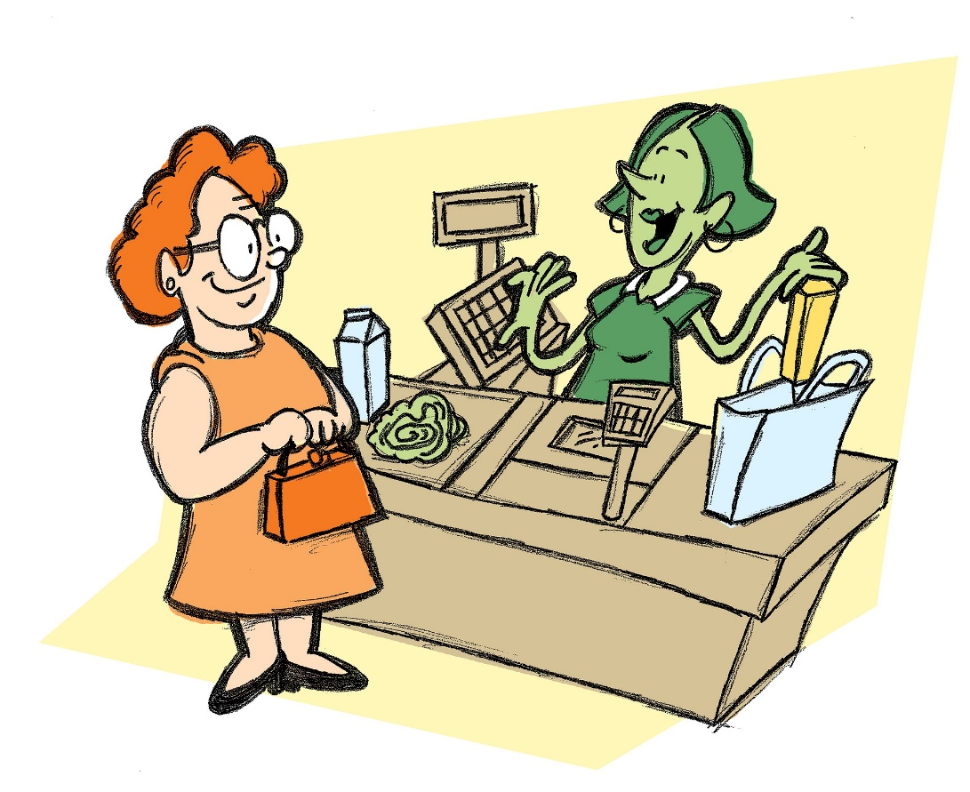

Human Resources
Capital Resources
Natural Resources
Notes:
Now, let’s look at the grocery store, Food R Us.
Does the grocery store use resources like Suzzy the peach farmer? Yes! Click for Clip Art
Natural resources: land which store is on, water (i.e. bathrooms) Click
Human resources: the workers to stock the food, keep the grocery store clean, check-out the customers Click
Capital resources: the machines (cash registers, fork lifts, shopping carts, etc) and tools Click
Are these resources free? No! Just like Suzzy, the grocery store must pay for the resources it uses. Food R Us must also cover its costs in order to pay the workers and have enough money for the company stakeholders (owners who ‘share’ the company) to have a profit (money left over after paying all the costs).
Don’t forget Food R Us had to buy the peaches (and all the food in the store) from other companies (farmers, food vendors, etc). This is another cost to the grocery store which has to be covered!
So then why does the Food R Us sell peaches cheaper than Suzzy the peach farmer? Click
Since Food R Us is a grocery store, many other items are available for their consumers to buy. So if peaches are not sold one day, the sales from all the other products will still help the store cover costs. The grocery store can afford to sell the peaches cheaper because of this.
For example, the Johnsons also bought apples, cereal, milk, and toilet paper. The money from these other products helps cover the cost of the cheaper peaches.
If Suzzy only sells peaches, then there is nothing else for her to sell to help her cover her costs. She’s relying only on the peach sales to cover her costs of farming. Suzzy must charge more for the peaches to help cover her costs.

Slide 6
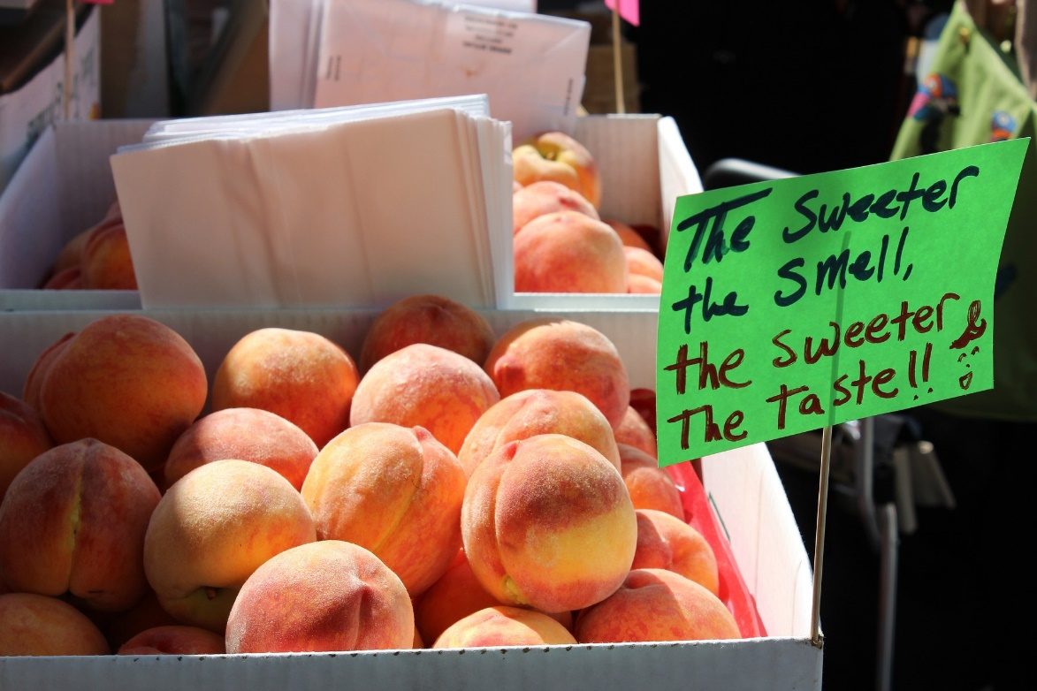
Notes:
Why do you think the Garcias bought their peaches from Suzzy’s stand? Why did the Johnsons buy from the grocery store?
Perhaps the Garcias drive by the peach stand every day on their way home from school.
Perhaps the Johnsons had other things to buy from the store, so they decided to buy their peaches there as well.
What if Suzzy’s peach stand was next door to Food R Us and she still charged more for her peaches?
More than likely, Suzzy the peach farmer, would have to either move her peach stand or lower the price of her peaches! Why?
Having cheaper peaches, most consumers will buy from Food R Us.
Would she lose all her costumers? Probably not!
Why would a consumer pay a higher price for a product that is cheaper from a different producer?
Perhaps Suzzy’s peaches taste better or are fresher than the peaches at Food R Us. Or perhaps someone in the household works for on the farm or is friends with Suzzy.
These two producers, Suzzy the peach farmer and Food R Us, are in competition with each other because they are selling the same product. This competition can be very strong, depending upon the consumers (households) needs and desires.
If the Garcias had to buy other products like sugar and milk, do you think they still would have bought the peaches from Suzzy?
Raise your hand if you would still buy the peaches from Suzzy. Why?
Raise your hand if you would buy the peaches from Food R Us. Why?
All your reasons are correct! It just depends on the consumer and how important the product price is compared to the need of the product.
If you were Suzzy the peach farmer and had your stand next to Food R Us, what would you do to help your business succeed?
Sell other products, reduce the prices on peaches, move locations, give farm tours, etc
As an entrepreneur, Suzzy would have to take a risk and try something new to help her business continue.

