Slide 1
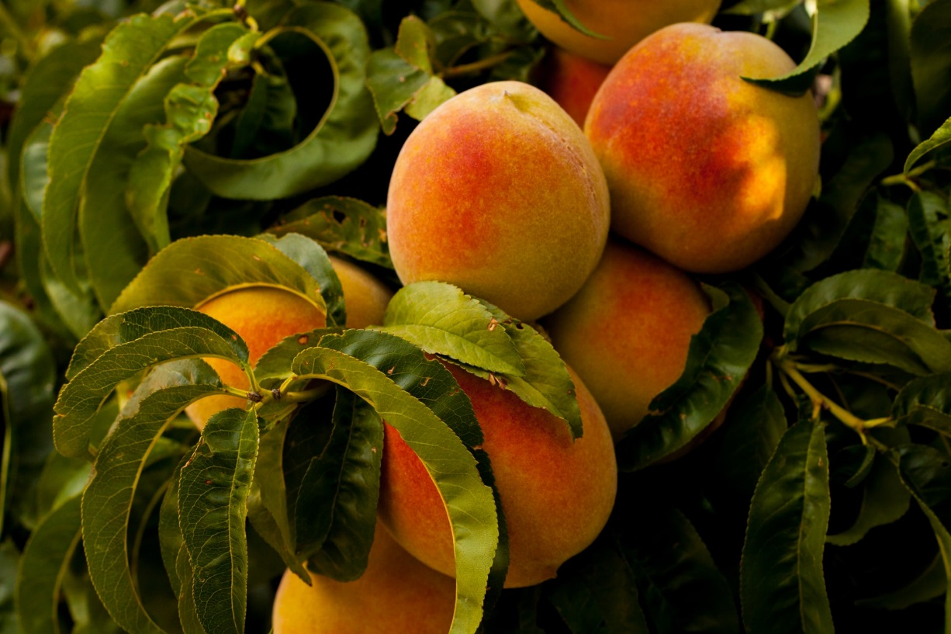
Why have Peach Farms?
Grade 4

Slide 2


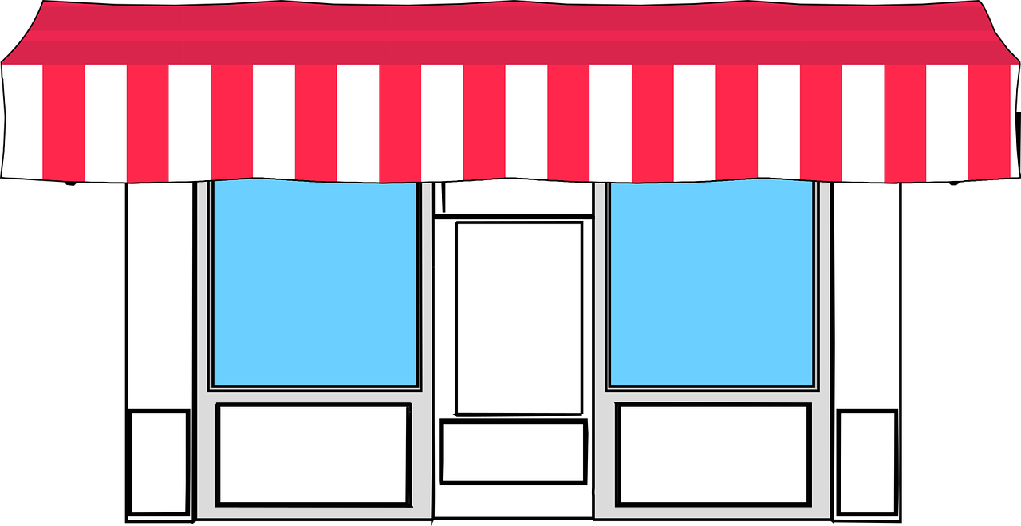

What is opportunity cost?
The value of the next best thing you give up whenever you make a decision!
=
Opportunity Cost
OR
Notes:
Who can tell me the definition or give me an example of opportunity cost? Click to show definition
The opportunity cost is the decision or option you decide not to take.
Let’s try an example. It’s time for dessert. You have the choice between vanilla ice cream and a piece of cake. Click for pictures
Who would choose ice cream? Who would choose cake?
If you choose the ice cream, then your opportunity cost would be the joy and taste of the piece of cake that you decided not to eat. If you don’t like cake, then the opportunity cost is low. If you do, then it might be higher.
If you choose the cake, then your opportunity cost would be what? The joy and taste of the ice cream you did not eat! If you don’t like ice cream, then this cost is low.
Here’s another example. Click once for food/door pictures to disappear and a store front to appear. You own a building and decide to turn it into a store. What types of stores could we turn it into?
Let’s turn it into a toy store. Click for photo
Would you still make money if you decided on a grocery store? Yes, but you are not going to make that money since you decided against the grocery store.
The opportunity cost is that possible money that you could have made if you turned the building into a different store.
Click for next slide

Slide 3
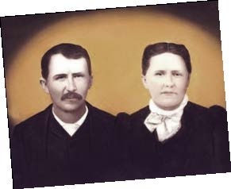

Do farmers experience opportunity cost?
Notes:
Do farmers experience opportunity costs? Let’s use My Family’s Peach Farm book to see.
Colt’s great, great grandparents started the peach farm in 1885. Were peaches the only think that they could have grown?
All those other crops you listed are the opportunity costs which Colt’s great, great grandparents had.
Click for possibilities road sign. There were other possibilities which they could have chosen.
So yes, even farmers have to think about the opportunity cost when they decide what to grow or raise on their farm!
Why do you think they decided to grow peaches instead of other crops?
The location was perfect for growing peaches (better temperatures, precipitation, and soil). Less resources were needed to grow peaches than other crops, so this meant less money was needed to start a peach farm.
Around that time, in the mid-late 1800s growing peaches became more of a possibility due to technology!
Click for next slide

Slide 4
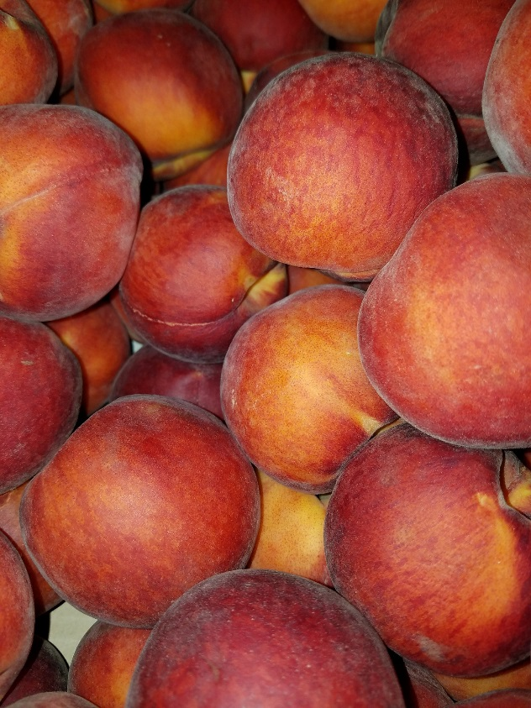

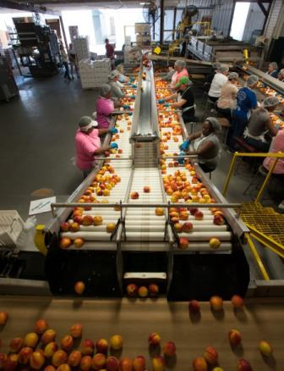
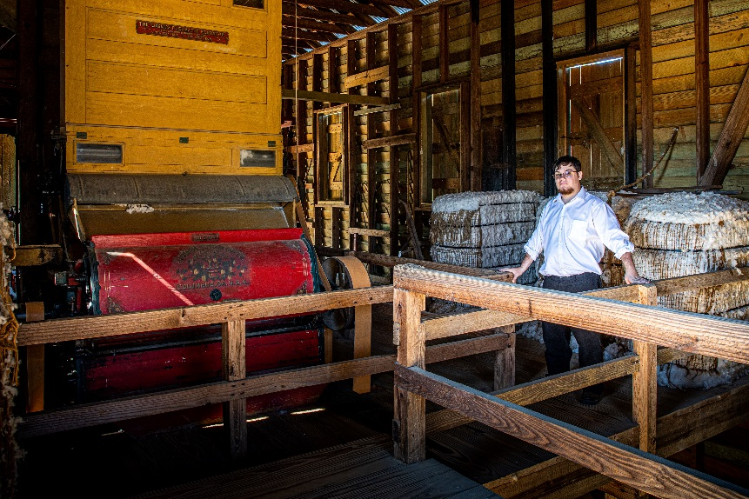
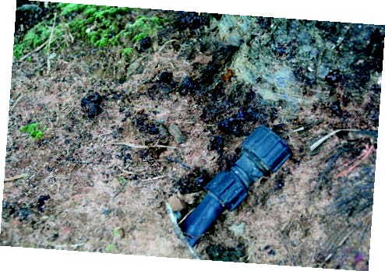
How does technology help farmers?
Photo Source: Georgia Peach Council
Notes:
Especially after the Civil War, southern farmers were looking into other crop options besides cotton. Samuel H. Rumph, a Georgian farmer, assisted in developing Georgia’s peach industry. Click for photo
He experimented with shipping peaches along the east coast, especially to New York. Mr. Rumph placed iceboxes (old-time refrigerators with ice) in the middle of a railroad car and then placed the boxed peaches around the iceboxes. This new system helped keep the peaches from spoiling during shipping and became one of the first ‘refrigerated’ railroad cars! Mr. Rumph’s experiment eventually helped others develop the modern refrigerated railroad cars.
Samuel Rumph also developed a new peach variety, which was named after his wife, Elberta. This peach variation (click for photo), which was a higher quality and more durable during shipping became the most common peach variety until 1960!
These new ideas and technologies allowed for Georgia peach farmers to produce higher quality peaches for commercial purposes!
This means Georgia farmers were able to sell their peaches to consumers even as far as New York! The new technology allowed peaches to stay fresher longer so they could be sent a further distance.
Georgia farmers were able to make more money since the northern consumers were willing to pay a higher price for a product that maybe was harder to find.
Can you name another invention that helped cotton farmers? How did it help the farmers make more money?
Click for photo. The cotton gin helped farmers speed up the process of removing the seeds, which lowered the cost of harvesting/shipping the cotton overall.
Technology can assists farmers decrease the cost of growing the crops. This decrease cost will help farmers increase the amount of money they can keep (profit).
Take a look at My Family Peach Farm and find new technology that helps the Pearsons’ decrease their overall cost of running farm.
Irrigation (drip tapes), pg 8; tractors, pg 16; conveyor belts, pg 17; sorting machine, pg 18; camera grading peaches, pg 19
After the students list the newer technology, one click will bring up the following photos/clipart: drip tape, conveyor belt, camera grading peaches
Do you think other farms of today have similar or different technology?
Dependent upon what the farm is growing/raising, some technology may be very similar (tractors, irrigation systems, conveyor belts).
Some technology may be very different, like automatic milking machines that are specialized for dairy cows.
Click for next slide

Slide 5


Why should we, as consumers, care?
Notes:
So why should we, as consumers, care about how farmers are affected by opportunity cost and technology? Any guesses?
Let’s look at an example. Who likes to wear t-shirts? Click for clipart
Does anyone know what many t-shirts are made out of? (provide a hint that it is a common crop in south Georgia.) Cotton! Click for clipart
We need cotton in order to make much of the clothing we wear.
If farmers decided to grow other crops in place of cotton, our clothing would be more expensive.
Technology helps farmers plant, harvest, and process cotton, which also brings down the price.

