Slide 1
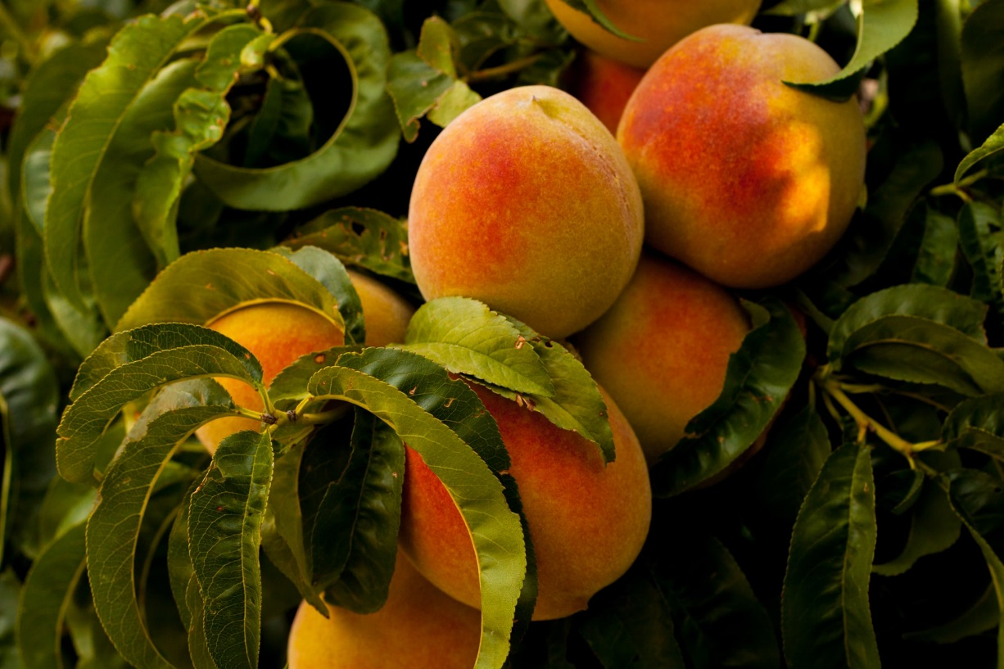
Are Farmers Entrepreneurs?
Grade 3

Slide 2
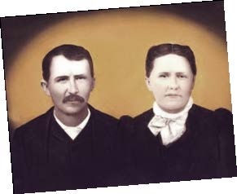

Farmers are Entrepreneurs!
=
A risk taker who attempts to make money by combining resources and providing a good or service.
Entrepreneur
Who were the entrepreneurs in My Family’s Peach Farm?
Notes:
Does anyone know the definition of an entrepreneur? Click to show the definition
Can anyone list any famous entrepreneurs? (Bill Gates, Oprah Winfrey, Walt Disney, J.K. Rowling, Henry Ford, Steve Jobs, Sam Walton)
From the book My Family’s Peach Farm, who are the entrepreneurs? Click to show the answer, great, great grandparents
Cort’s great, great grandparents looked at their resources and took the risk to start growing peaches
Click for next slide

Slide 3
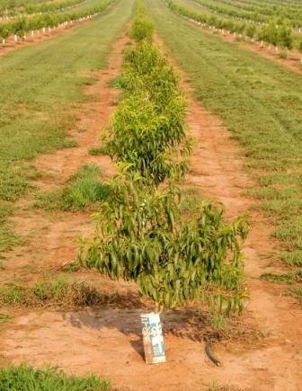

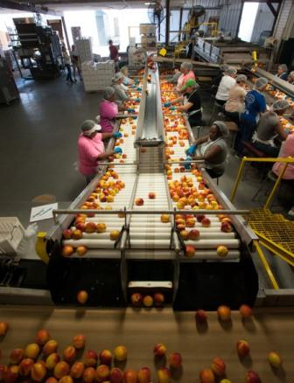
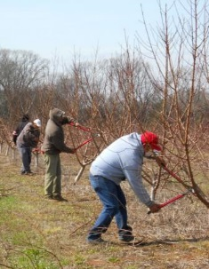


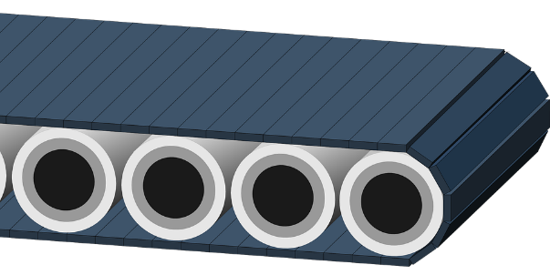
What Resources do Farmers Use?
Productive Resource
=
Something that is used to make a product or provide a service
Natural Resource
Capital Resource
Human Resource
Notes:
What Resources do Farmers Use?
Remember, resources help entrepreneurs make products or provide a service.
Let’s use My Family’s Peach Farm and see if we can find examples of the resources they use. What are some things that the Pearson’s use on their peach farm?
Have students list the various machinery, workers, and other items which were used in the book.
All these are types of productive resources. Click for definition.
There are categories or types of productive resources.
First, there are natural resources. Click for text ‘natural resource’
What are the natural resources which the Pearsons use? (peach trees, water, soil/land)
Anything that comes from nature can be considered a natural resource! Click for clipart of resources, ending with peach tree photo.
Second, there are capital resources. Click for text ‘capital resources’
Capital resources are those man-made items which are needed to make a product or provide a service.
What are capital resources that the Pearson Farm uses? (pruning shears, wagons, tractors, cameras, drip tapes for water, conveyer belts) Click for clipart of resources, ending with conveyer belt photo
Third, there are human resources. Click for text ‘human resources’
Who do you think the human resources are? The workers!
At the Pearson Farm, the pruners (click for pruning photo), the pickers, and anyone else who works on the farm are considered human resources.
These are workers who are paid to help the entrepreneur make a product or provide a service.
Click for next slide

Slide 4
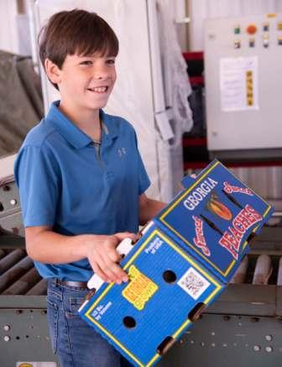
There’s a Fourth Resource!
Entrepreneurship
Notes:
There’s a fourth resource, the farmers themselves! Click for photo
Remember entrepreneurs are those who take a risk and use resources to make a product or provide a service.
Entrepreneurship is the fourth productive resource because someone needs to combine and manage all the other resources. Click for text ‘entrepreneurship’
Farmers are examples of the entrepreneurship resource! For the Pearson Peach Farm, who were the original entrepreneurs? Colt’s great, great grandparents, Moses Winlock and Cornelia Emory Pearson!
Click for next slide

Slide 5
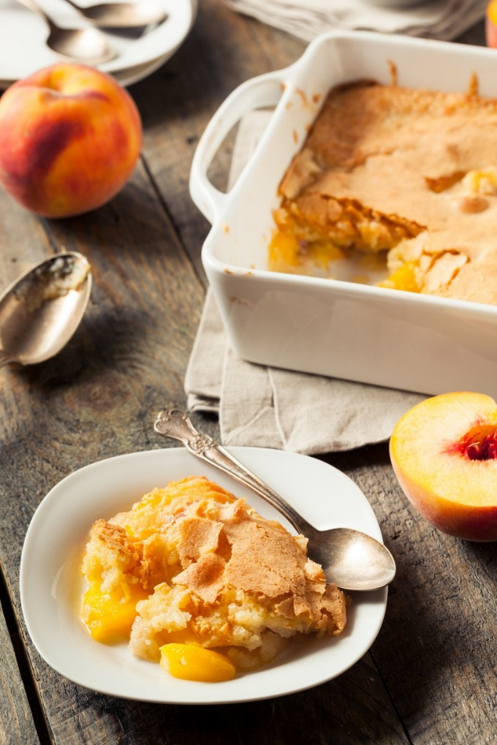
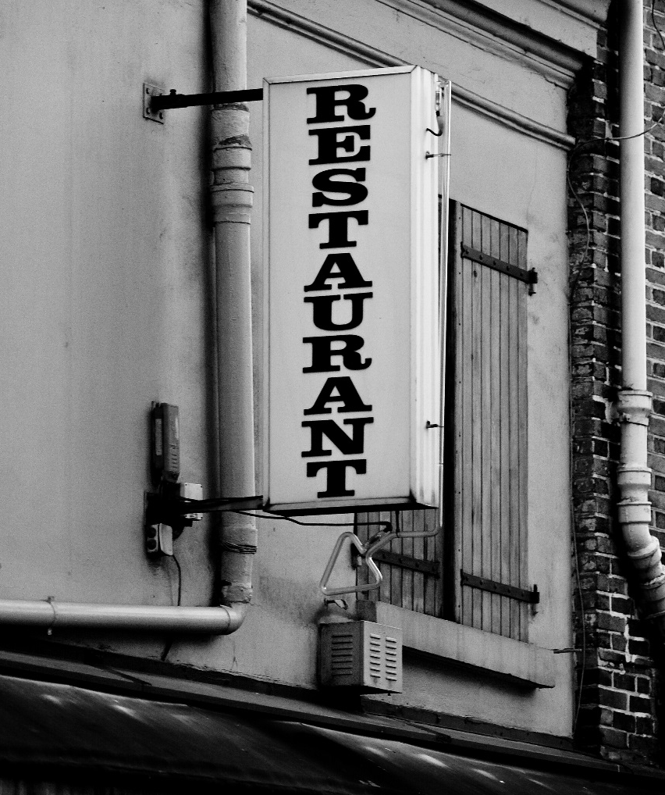

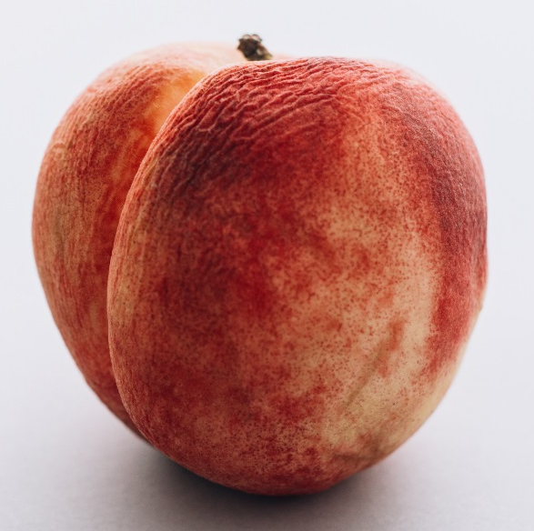
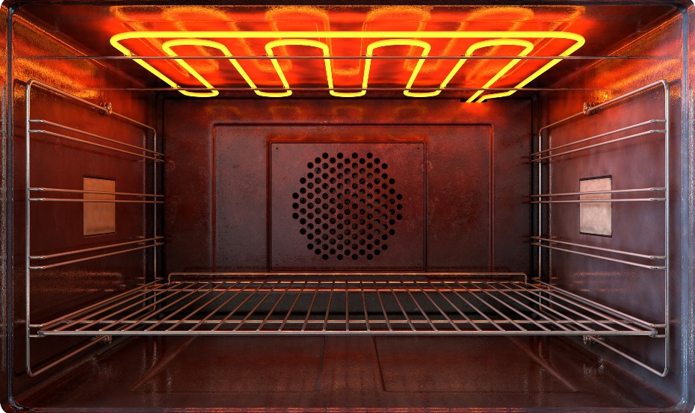
Entrepreneurship
Natural Resource
Capital Resource
Human Resource
Notes:
We are restaurant owners. Because we are taking a risk and owning a restaurant to provide food, what are we? Entrepreneurs! Click for text ‘entrepreneurship’
We want to start selling peach cobbler. Click to show cobbler picture
Let’s think about our different types of resources and decide what is needed make and sell peach cobbler?
Click for text ‘natural resources.’ Peach cobbler photo will shrink. Are there any natural resources that we will need for the peach cobbler? Peaches! Click for peach photo
This is a natural resource because peaches grow on trees and trees are a part of nature.
Click for text ‘capital resources.’ What is used to make the peach cobbler? Bowls, utensils, baking dishes, an oven. Click for oven photo
An oven is an example of a capital resource. Remember, any tools, machines, or other man-made items used to make a product or used for a service is a capital resource.
Click for text ‘human resources.’ Who makes the peach cobbler? The cook! Click for cook photo
The people who work to make the product or provide the service are called human resources. The cook is an example of a human resource. Are there any other human resources in a restaurant? (servers, hostesses, cashiers)
We can’t forget us, or the owners of the restaurant! What are we called again? Entrepreneurs!
Remember entrepreneurs are those who take a risk and use resources to make a product or provide a service. Click for text ‘entrepreneurship’
Click for next slide

Slide 6

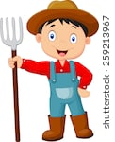
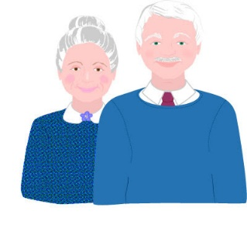

Match the resources!
Capital
Human
Natural
Entrepreneurship
(think original owners)
Notes:
1. Let’s review! Match the resources with the proper picture.
Clicking will reveal the proper answer in the order of the resources
Capital = conveyer belt
Human = farm worker
Natural = water
Entrepreneurship = grandparents

