Slide 1
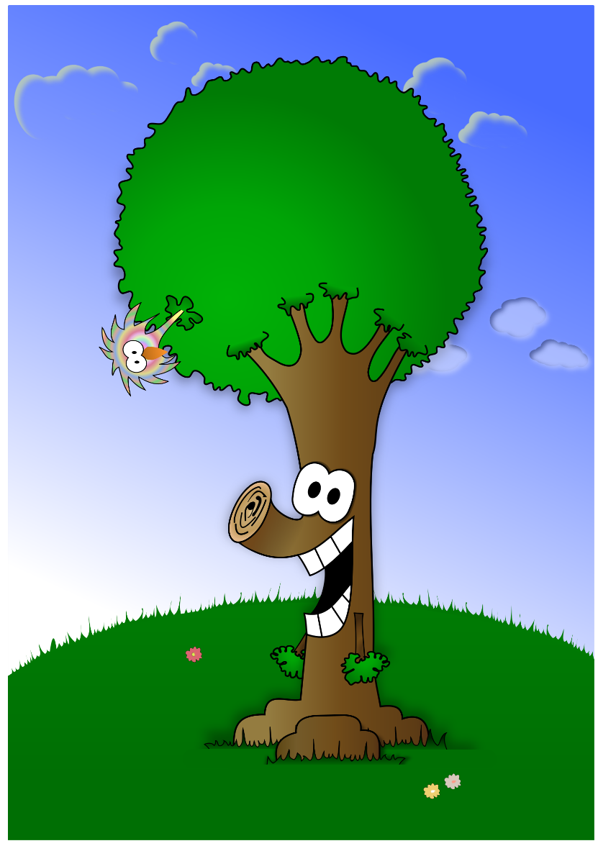

How does a Tree Talk to You?

Slide 2
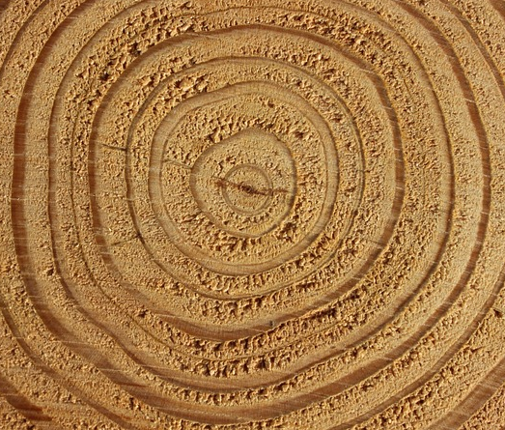
Through its tree rings!
Each tree ring shows us how much the tree grew in that season.
There are two growing seasons in one year!
Notes:
Introduce tree rings. Tree rings allow us to see how much the tree has grown in one season.
Click to show arrows pointing to two different rings.
Click to explain there are two growing seasons in one year.

Slide 3
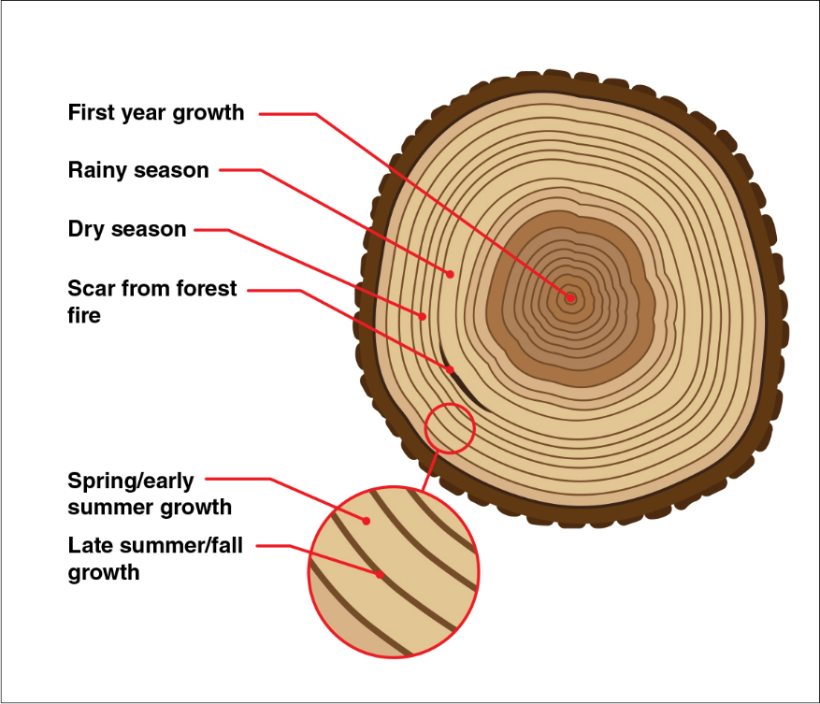
How a tree grows.
Light rings show growth in the spring season.
Dark rings show growth in the winter/fall season.
spring growth
winter/fall growth
Notes:
Trees usually grow more in the spring because the conditions are best (more water, sun, and appropriate temperatures). That’s why spring season rings are usually thicker.
During the winter/fall, trees become dormant and do not grow as much.

Slide 4
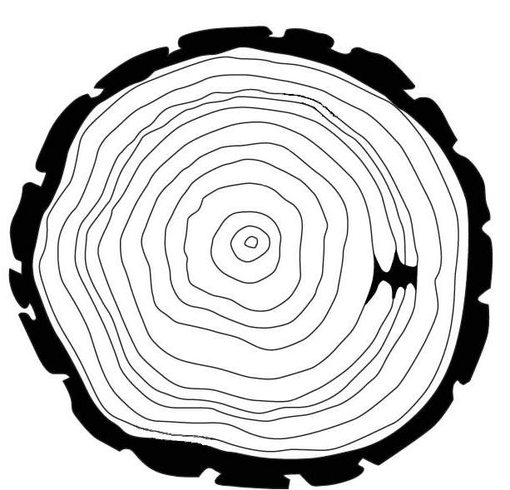
How old is this tree?
1 light ring + 1 dark ring = 1 year for the tree
How many dark rings do you see in this picture?
1
2
7
3
8
5
4
6
9
10
11
12
12
Notes:
Click to show arrows pointing to 1 light ring and 1 dark ring.
Count together! Each click traces a dark ring to count (arrows will disappear).
Click to show the answer.

Slide 5

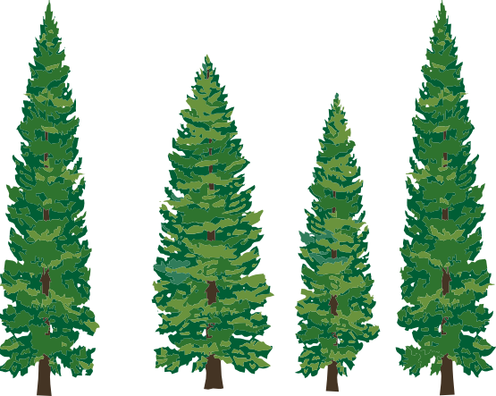



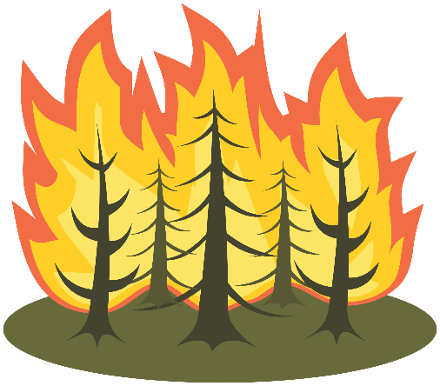

What affects a tree’s growth?
Notes:
Discuss what trees need to grow. If these things are reduced or limited in any way, than the tree may not grow very much.
Click to show rain
Droughts will reduce growth
Click to show sun
Too much or too little sun will reduce growth
Click to show crowding trees
If trees are too crowded, then there is competition for food
If there was only 1 pizza for your whole class, would everyone receive a piece? No, so students would compete for those pizza slices.
Click to show thermometer
Trees like a range of temperatures; too hot or too cold can reduce growth
Other factors affecting tree growth are:
Click to show beetle
Insects can kill trees
Click to show germ
Trees become ‘sick’ with disease which can spread from tree to tree
Click to show forest fire
Prescribed fires are helpful and can help trees; if the fires are too hot, than they can damage the forest

Slide 6
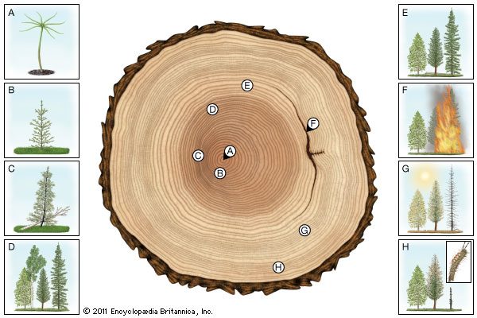
How do these factors affect a tree’s growth?
Notes:
This tree cookie shows how the different environmental factors can be seen in the tree rings.
A: seedling’s first year
B: first few years of growth are good
C: tree is crowded due to a tree falling on it
D: tree becomes shaded and growth is reduced
E: tree has more space after bigger tree was harvested
F: prescribed fire; helps reduce competition from other plants
G: drought; not enough sun
H: insect damage

Slide 7
What does this tree tell us about its life?
This tree was cut down in 2018.
When did really good growing conditions occur?
When did the fire occur?
When did poor growing conditions affect the tree’s growth?
Notes:
By looking at the rings, we can see what the environment was like in the past.
Good growing conditions early in trees life; spring of 2011
Fire occurred winter of 2012
Poor growing conditions during 2012-2015
Answers can be off 1 year, depending upon where they started counting along tree rings.

