Slide 1
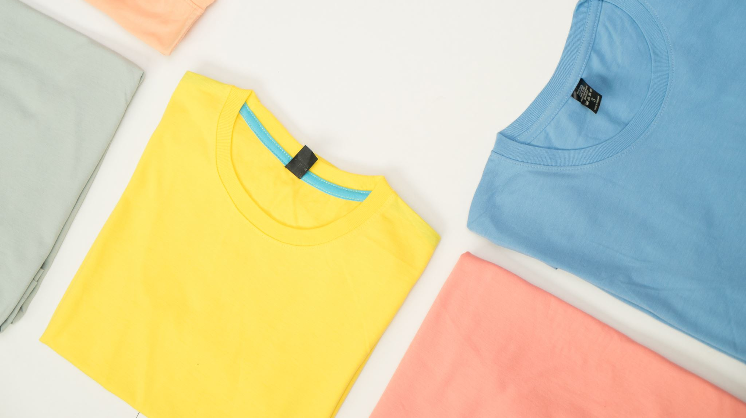


How Does Cotton Make A Shirt?
My Family’s Cotton Farm Social Studies Lesson
Notes:
Remind the students that it takes steps to make something. This is about the steps to making a shirt.

Slide 2
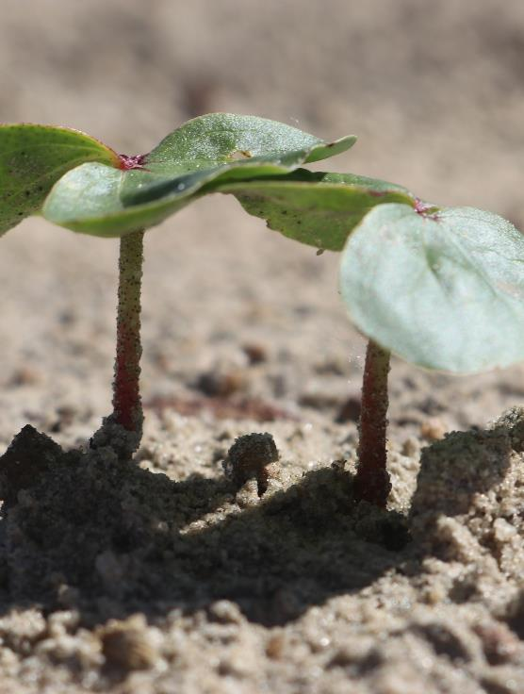
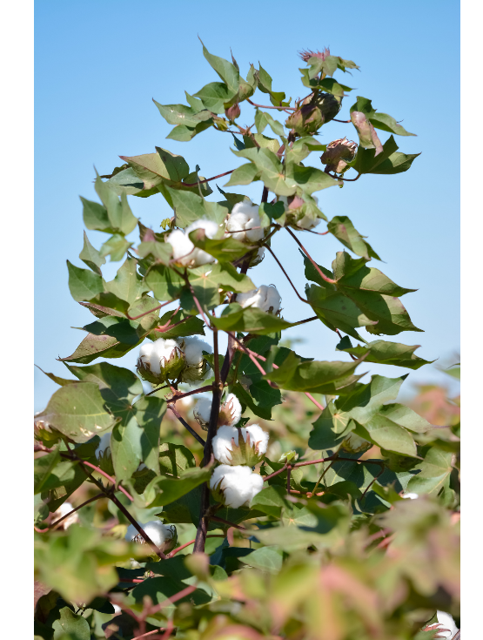
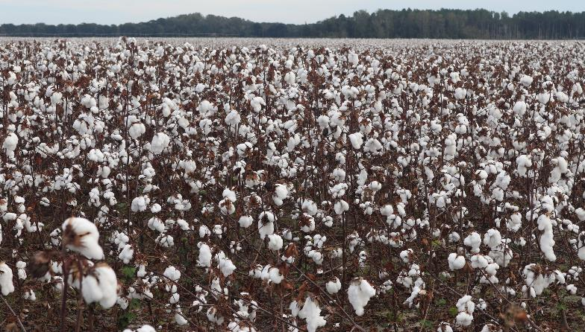
What Is Cotton?
Cotton is a plant.
Farmers grow cotton in fields.
Notes:
Remind the students of My Family’s Cotton Farm. Discuss how cotton is a plant that farmers grow for us to use. Cotton is one type of crop that farmers grow.

Slide 3
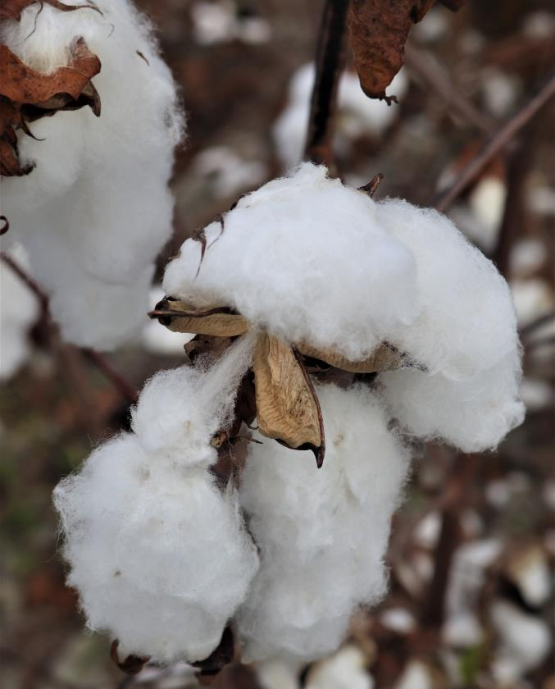
Why Grow Cotton?
The white fluffy cotton can be made into many different things that we use.
The leftovers, like seeds and plant parts, can be used to make animal feed.
Notes:
Click for the top green arrow to appear: point out to students that the white fluffy stuff (fibers) is what is used to make most items from cotton
Click for the bottom green arrow to appear: point out to students that the ‘leftovers,’ like the seeds and dead plant material, is used to make livestock feed.

Slide 4
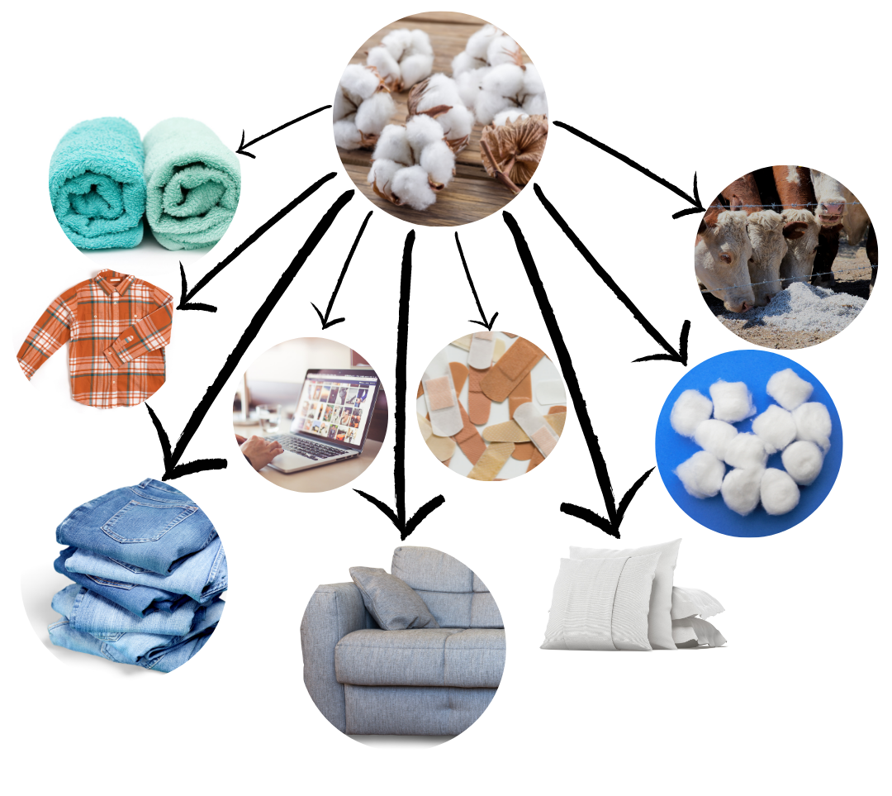
Name Something Made From Cotton
Notes:
Have the students look at the pictures to discover more cotton products.

Slide 5
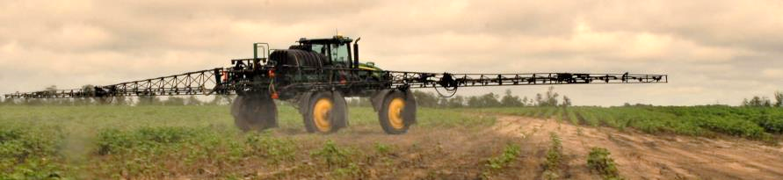
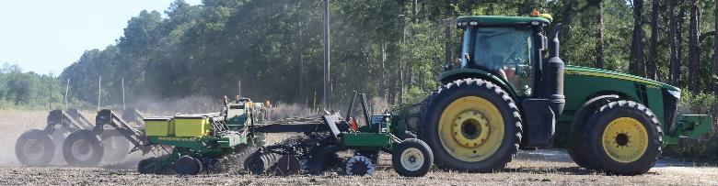
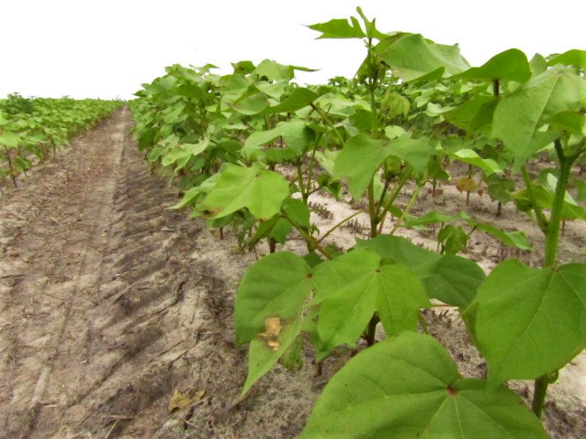
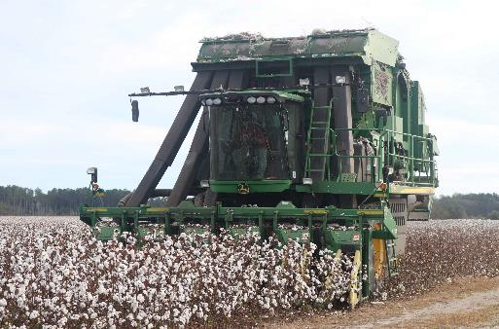
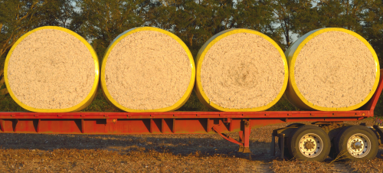
Name the Steps to Grow Cotton
1. Get the soil ready.
2. Plant the seeds.
3. Cotton grows.
4. Pick the cotton.
5. Cotton goes to the gin.
Notes:
Discuss transition words (first, second, third; first, then, finally; after, then) by having the students name the steps to grow cotton.

Slide 6
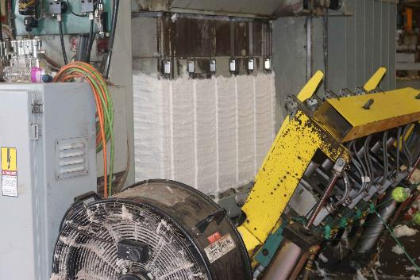
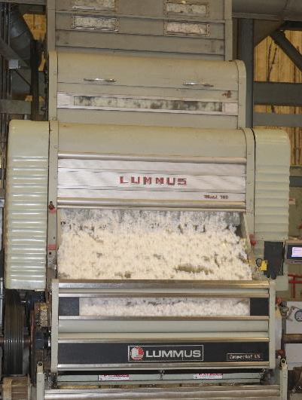
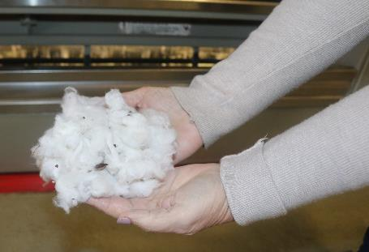
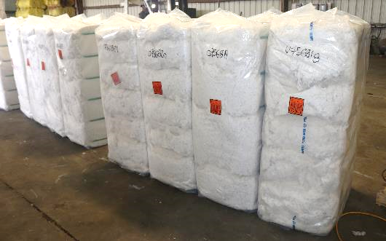
Step 1: The Cotton Gin
The cotton gin is a machine that takes out the cotton seeds from the white fluffy cotton, or lint.
The fluffy cotton, or lint, is pressed into a bale.
The lint bales wait to be sent to factories. The factories make fabric.
Notes:
Discuss the first step after harvesting, the cotton gin. The gin is a machine which separates the seed from the fibers (shown). Click to show how the fibers, or lint, is pressed into a bale. Click to show the stored bales waiting to be sent to factories for processing. Many times these are textile factories which make cotton fabric.

Slide 7
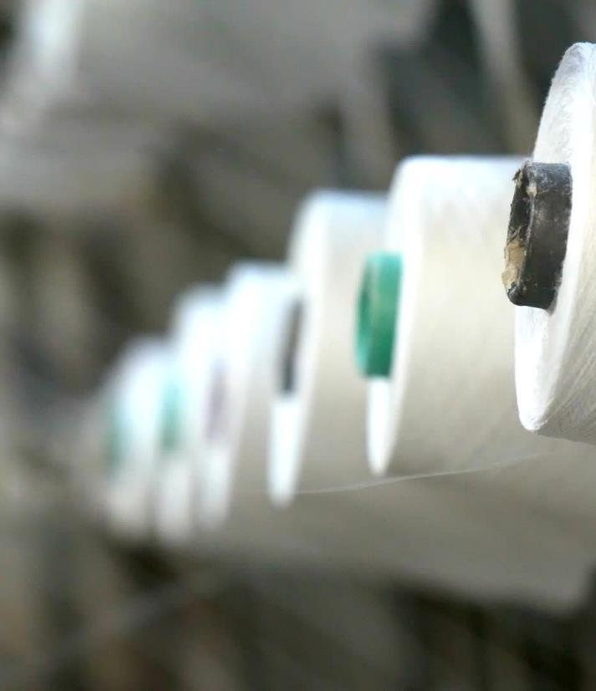

Step 2: Spinning
Next, the cotton is spun into thread.
Cotton is spun into thread, so it is easier to make clothes out of.
Notes:
The lint is eventually spun into thread. Thread can be very thin (perhaps bring in a spool of thread) or it can be spun thicker, like yarn.

Slide 8
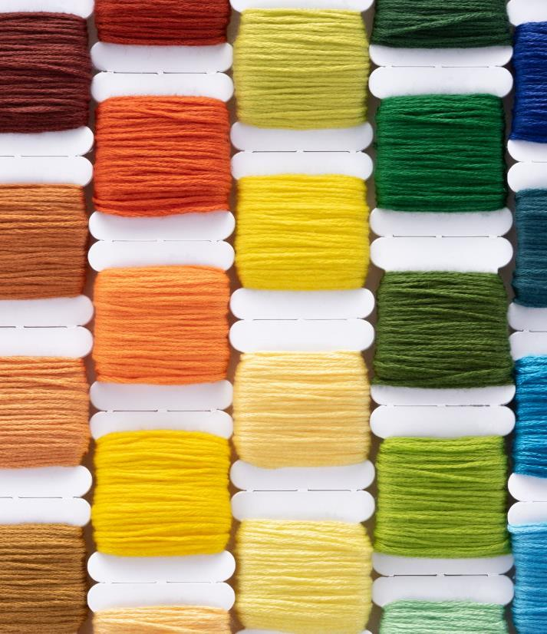
Step 3: Dyeing, or Changing Colors
After the cotton is spun into thread, it can by dyed to change color.
What are some colors you would change your thread?

Slide 9
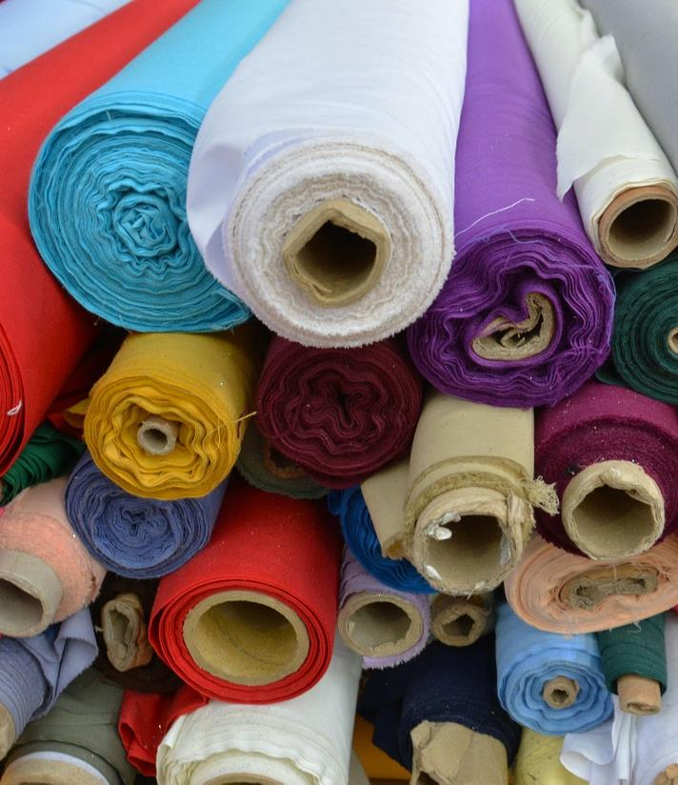

Step 4: Weaving
Now the cotton is woven into fabric. Have you seen fabric at the store?
Cotton fabric can be used to make many different types of clothes and materials.
Notes:
Some of the fabric is sent to other factories to make the clothes; while other bolts of fabric is sent to stores. Consumers can buy bolts of fabric for their own use.

Slide 10
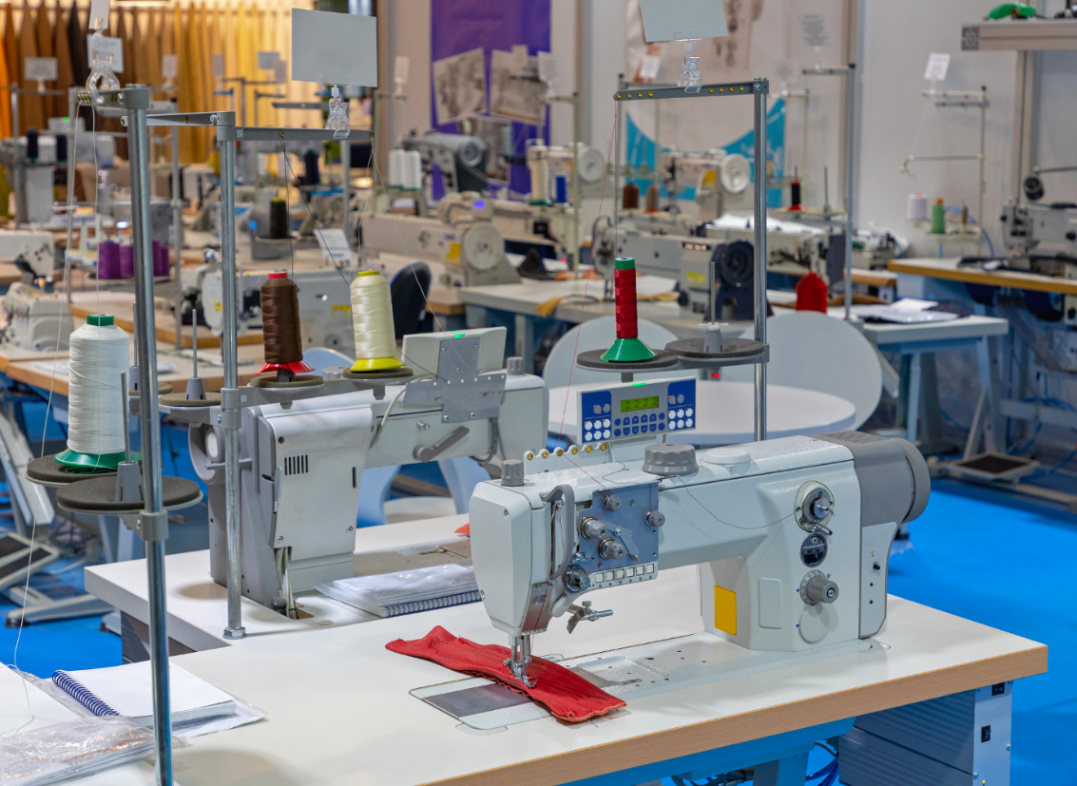
Step 5: Sewing
Cotton fabric can now be used to sew shirts!
Does someone in your family use cotton fabric to sew?

Slide 11

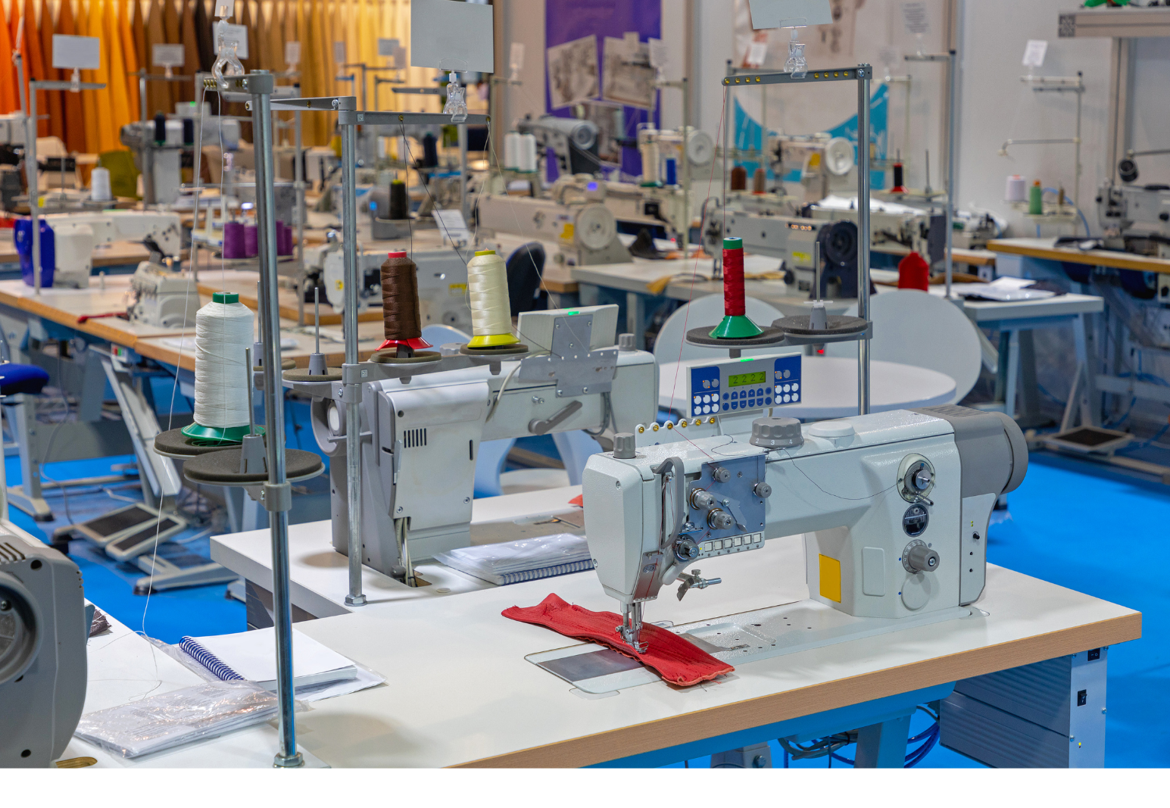
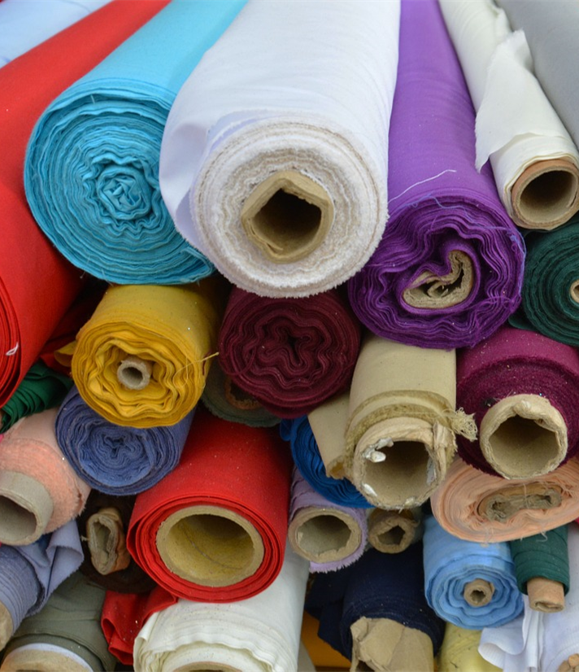
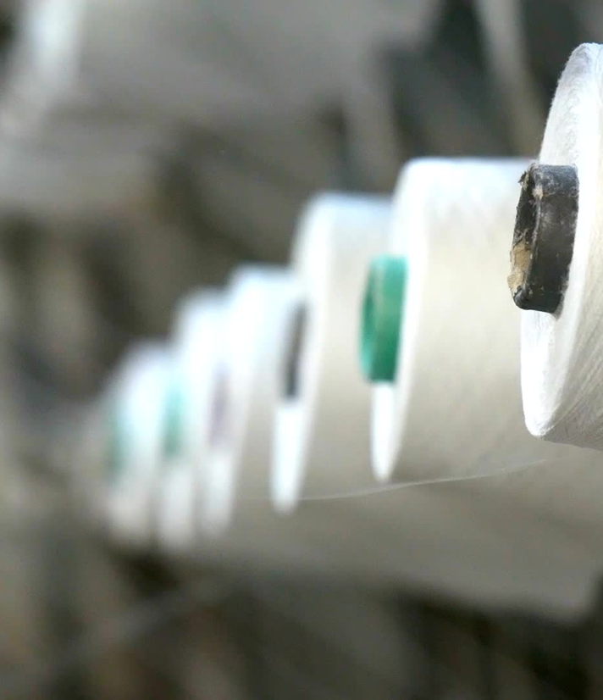
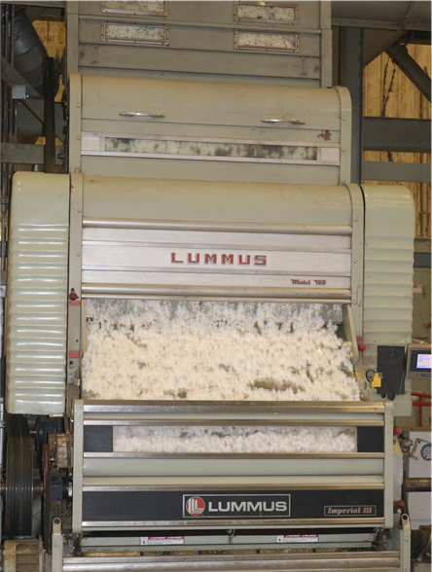
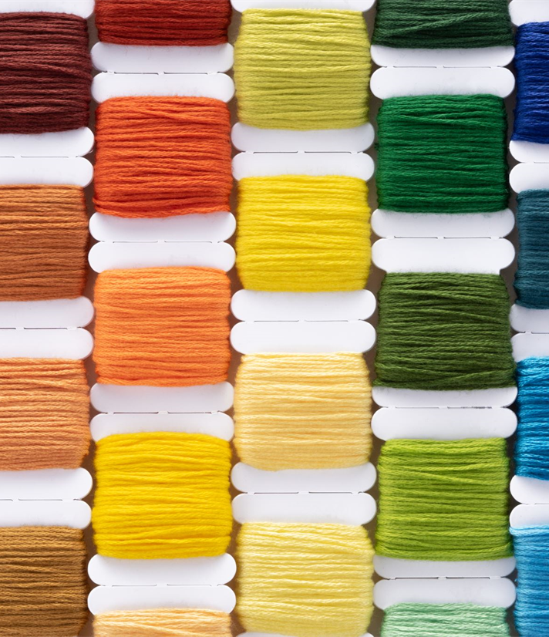
The pictures are in the wrong order! Help find the right order.
1
The Gin
2
Spinning
3
Dyeing
4
Weaving
5
Sewing
Notes:
Have the students put the pictures in order. The numbered steps are correct and that can help provide hints. When ready, click the right mouse button and the pictures will move in the correct order.

Slide 12
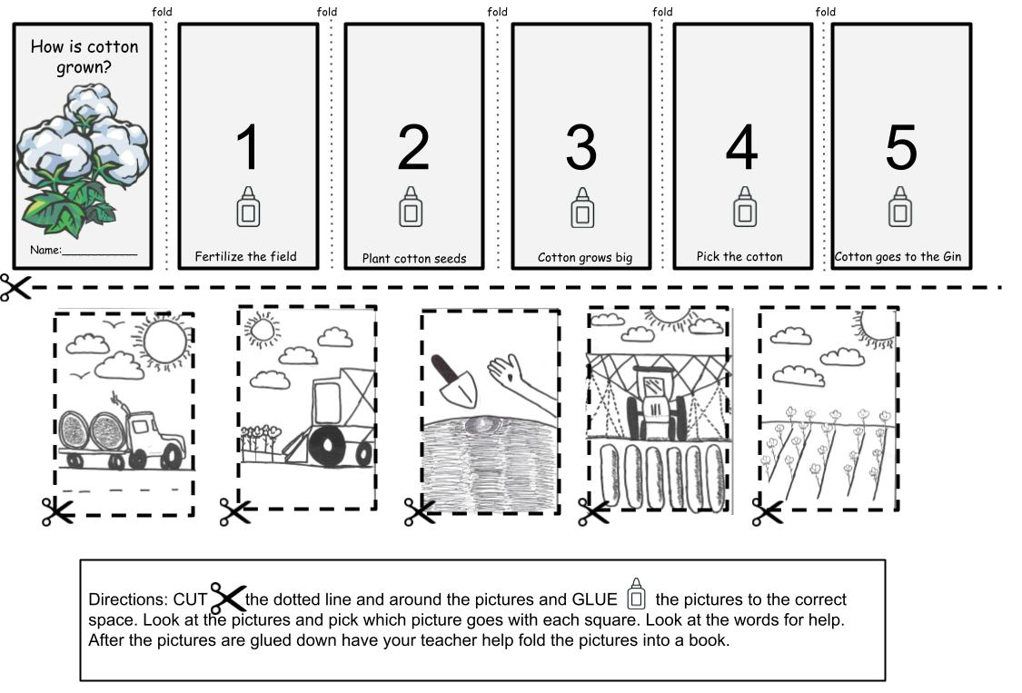
Worksheet Directions
Cut the paper in half on the dotted line
Cut the pictures out on the dotted lines
Glue the pictures in the right boxes
Fold the booklet
Notes:
Detailed instructions:
Instruct students to use scissors to cut the paper in half along the long dotted line
Then instruct students to cut around the pictures with the dotted lines
Allow students to apply glue to each box with the glue icon
Guide the students on where each picture fits into the sequence
Help students fold their newly placed pictures into a book
Begin by folding the title page towards the back then folding the first picture to the inside, repeat with the rest of the pictures (accordion folding)

